Slide 1
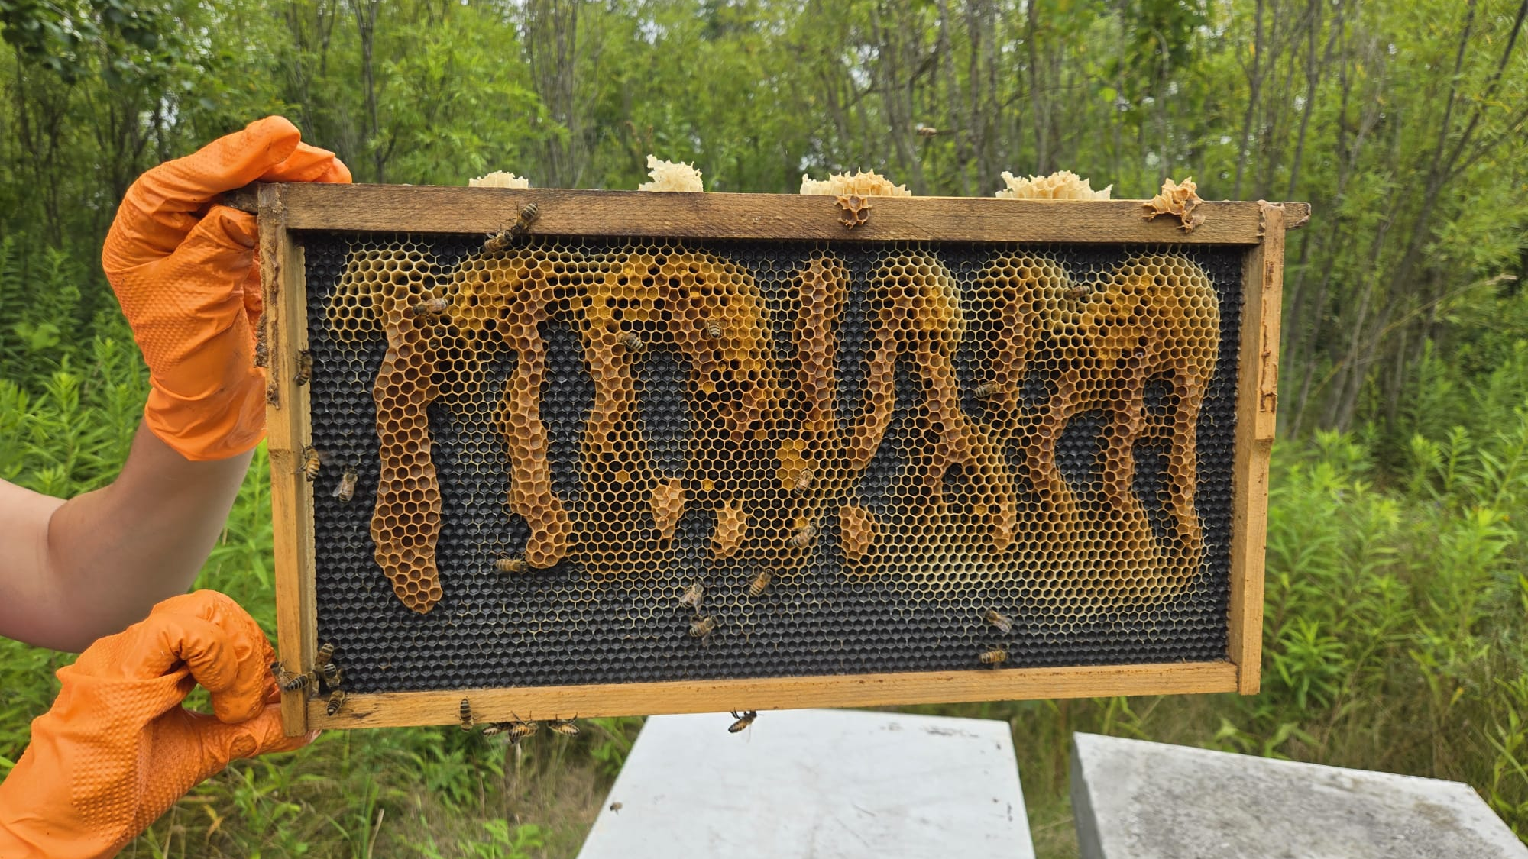
Splitting Colonies
To Prevent Swarms

Slide 2
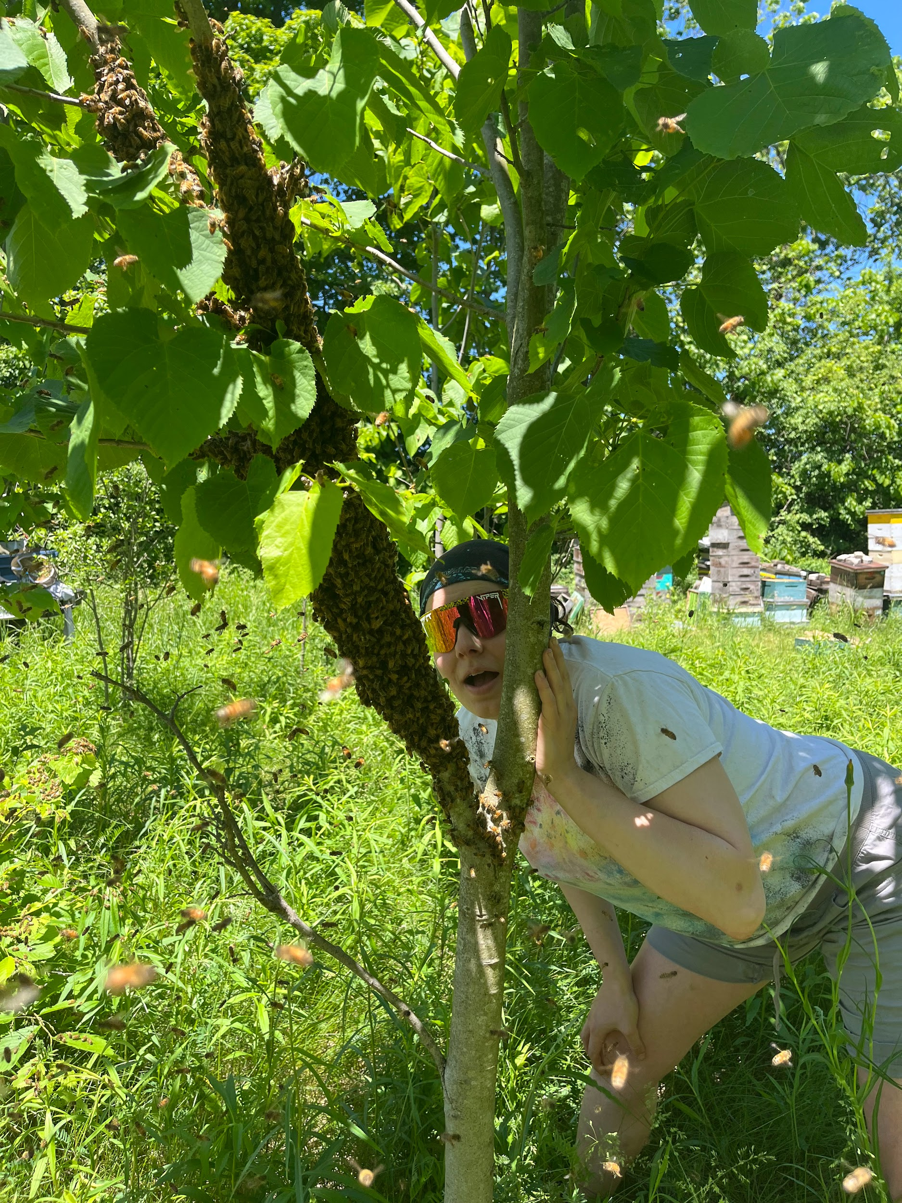
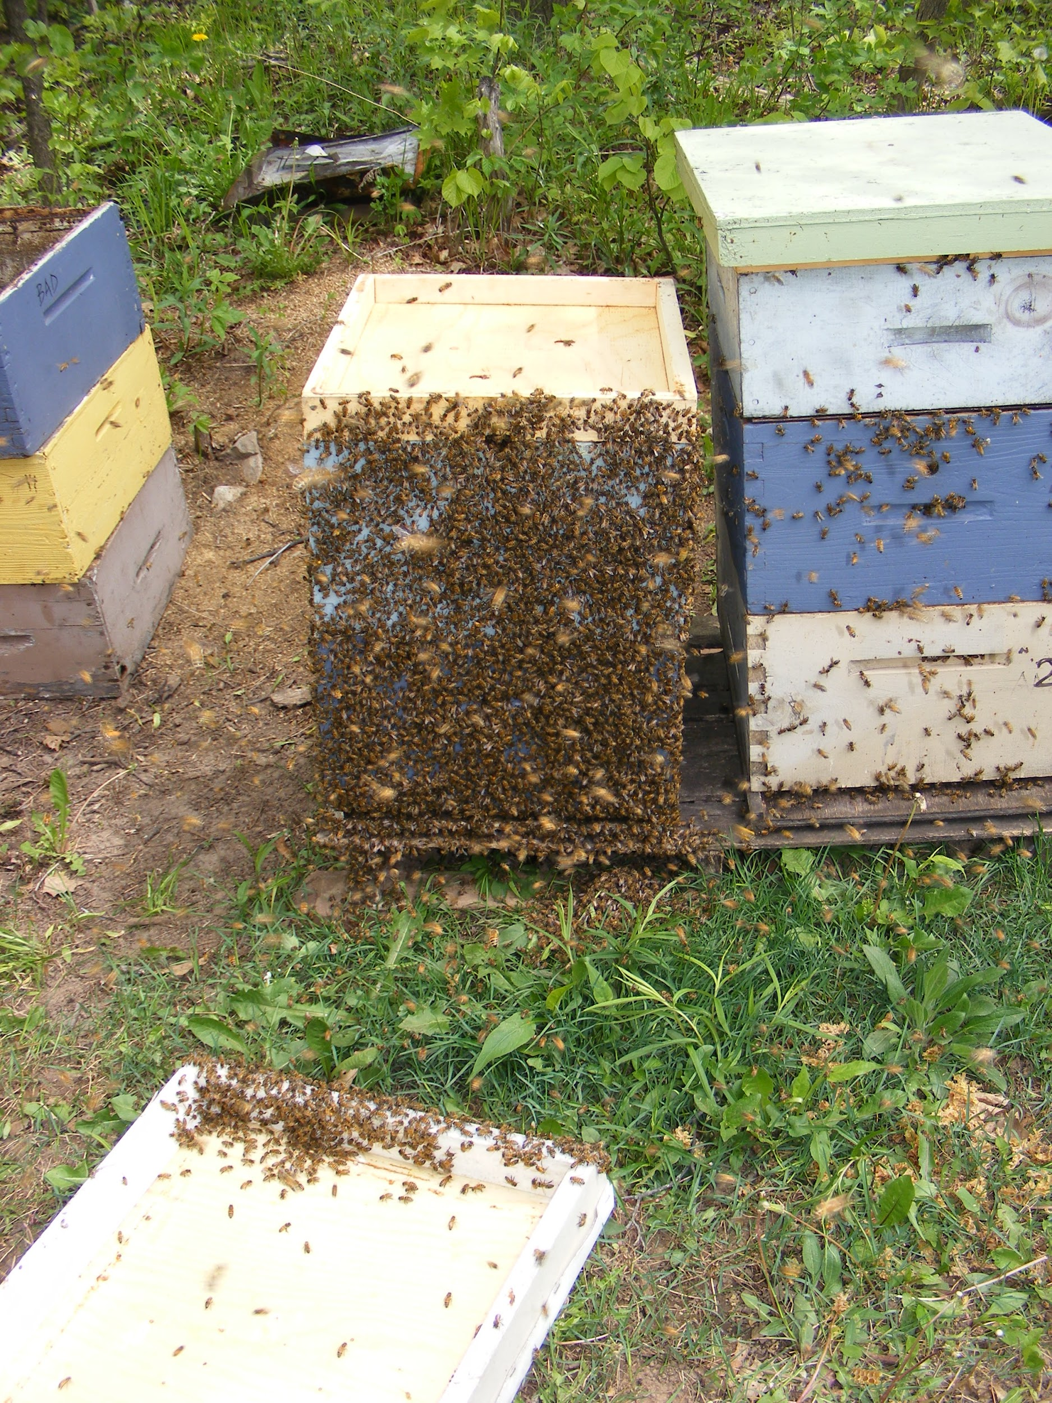
Swarm Biology:
Why Colonies Swarm
Congestion
Reduced laying space
Large population
Queen Pheromone status
Queen age
Congestion
Genetics

Slide 3
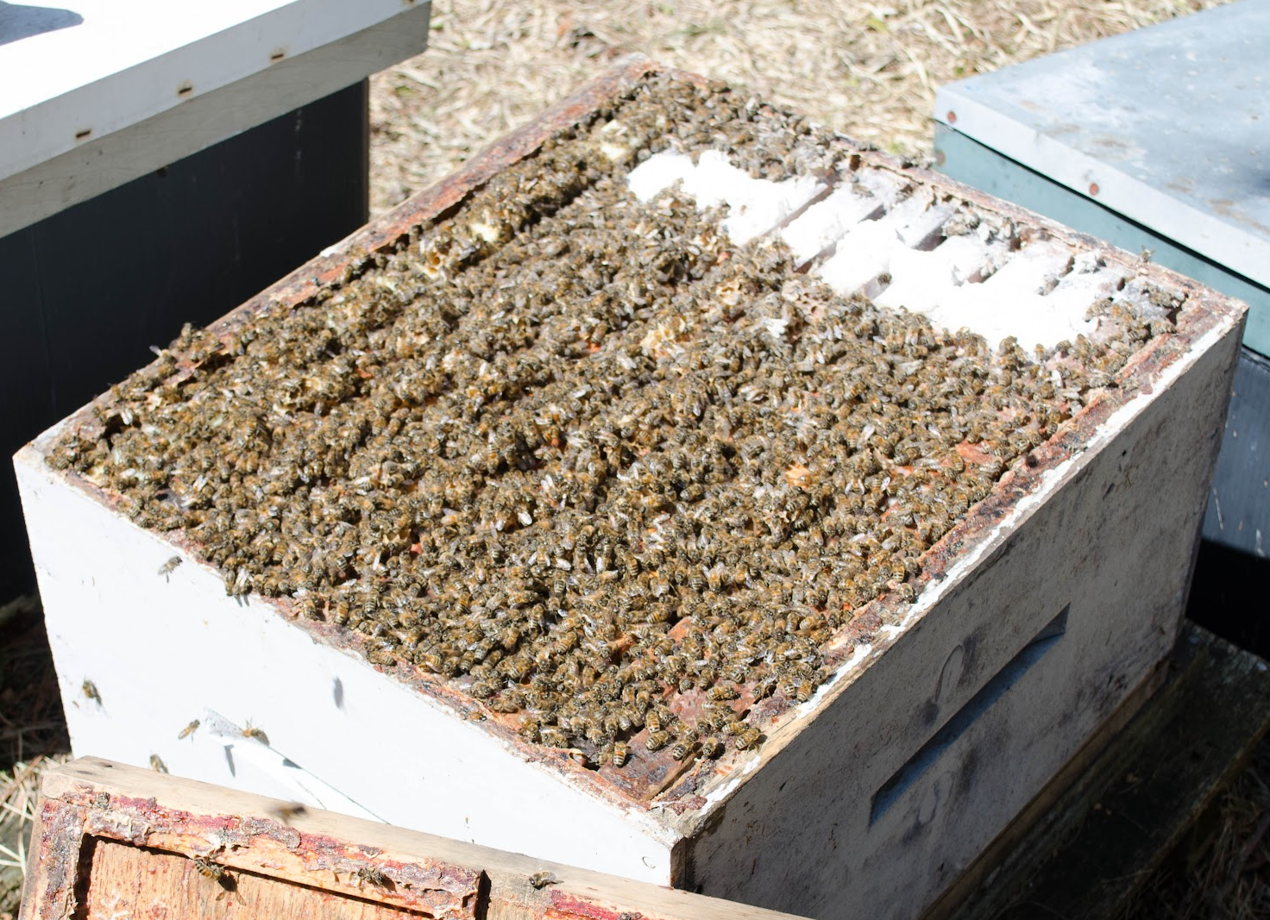
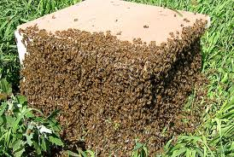
Swarm Biology:
Types of Swarms
Reproductive
Congestive

Slide 4
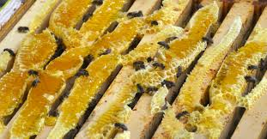
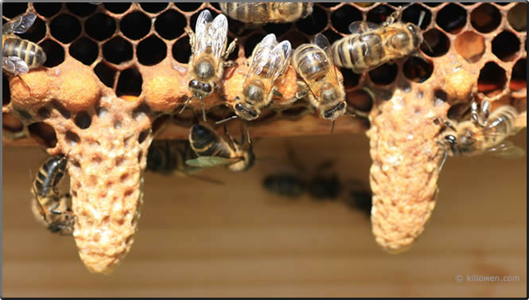
Swarm Biology:
Identifying Swarms

Slide 5
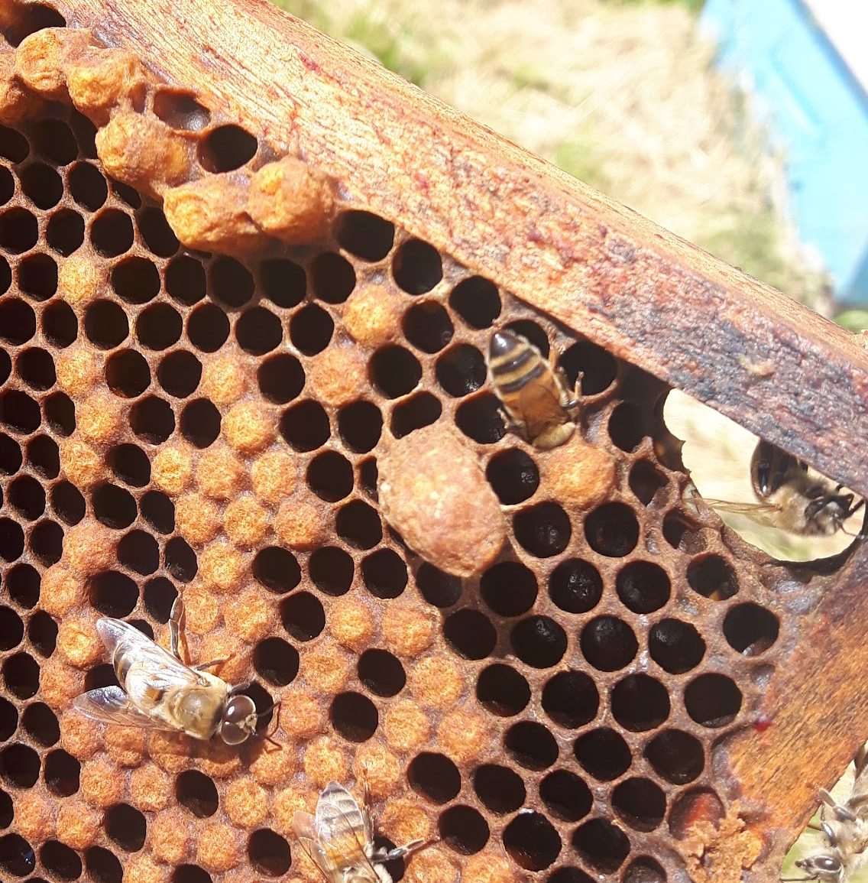
Swarm Biology:
Cell Identification

Slide 6
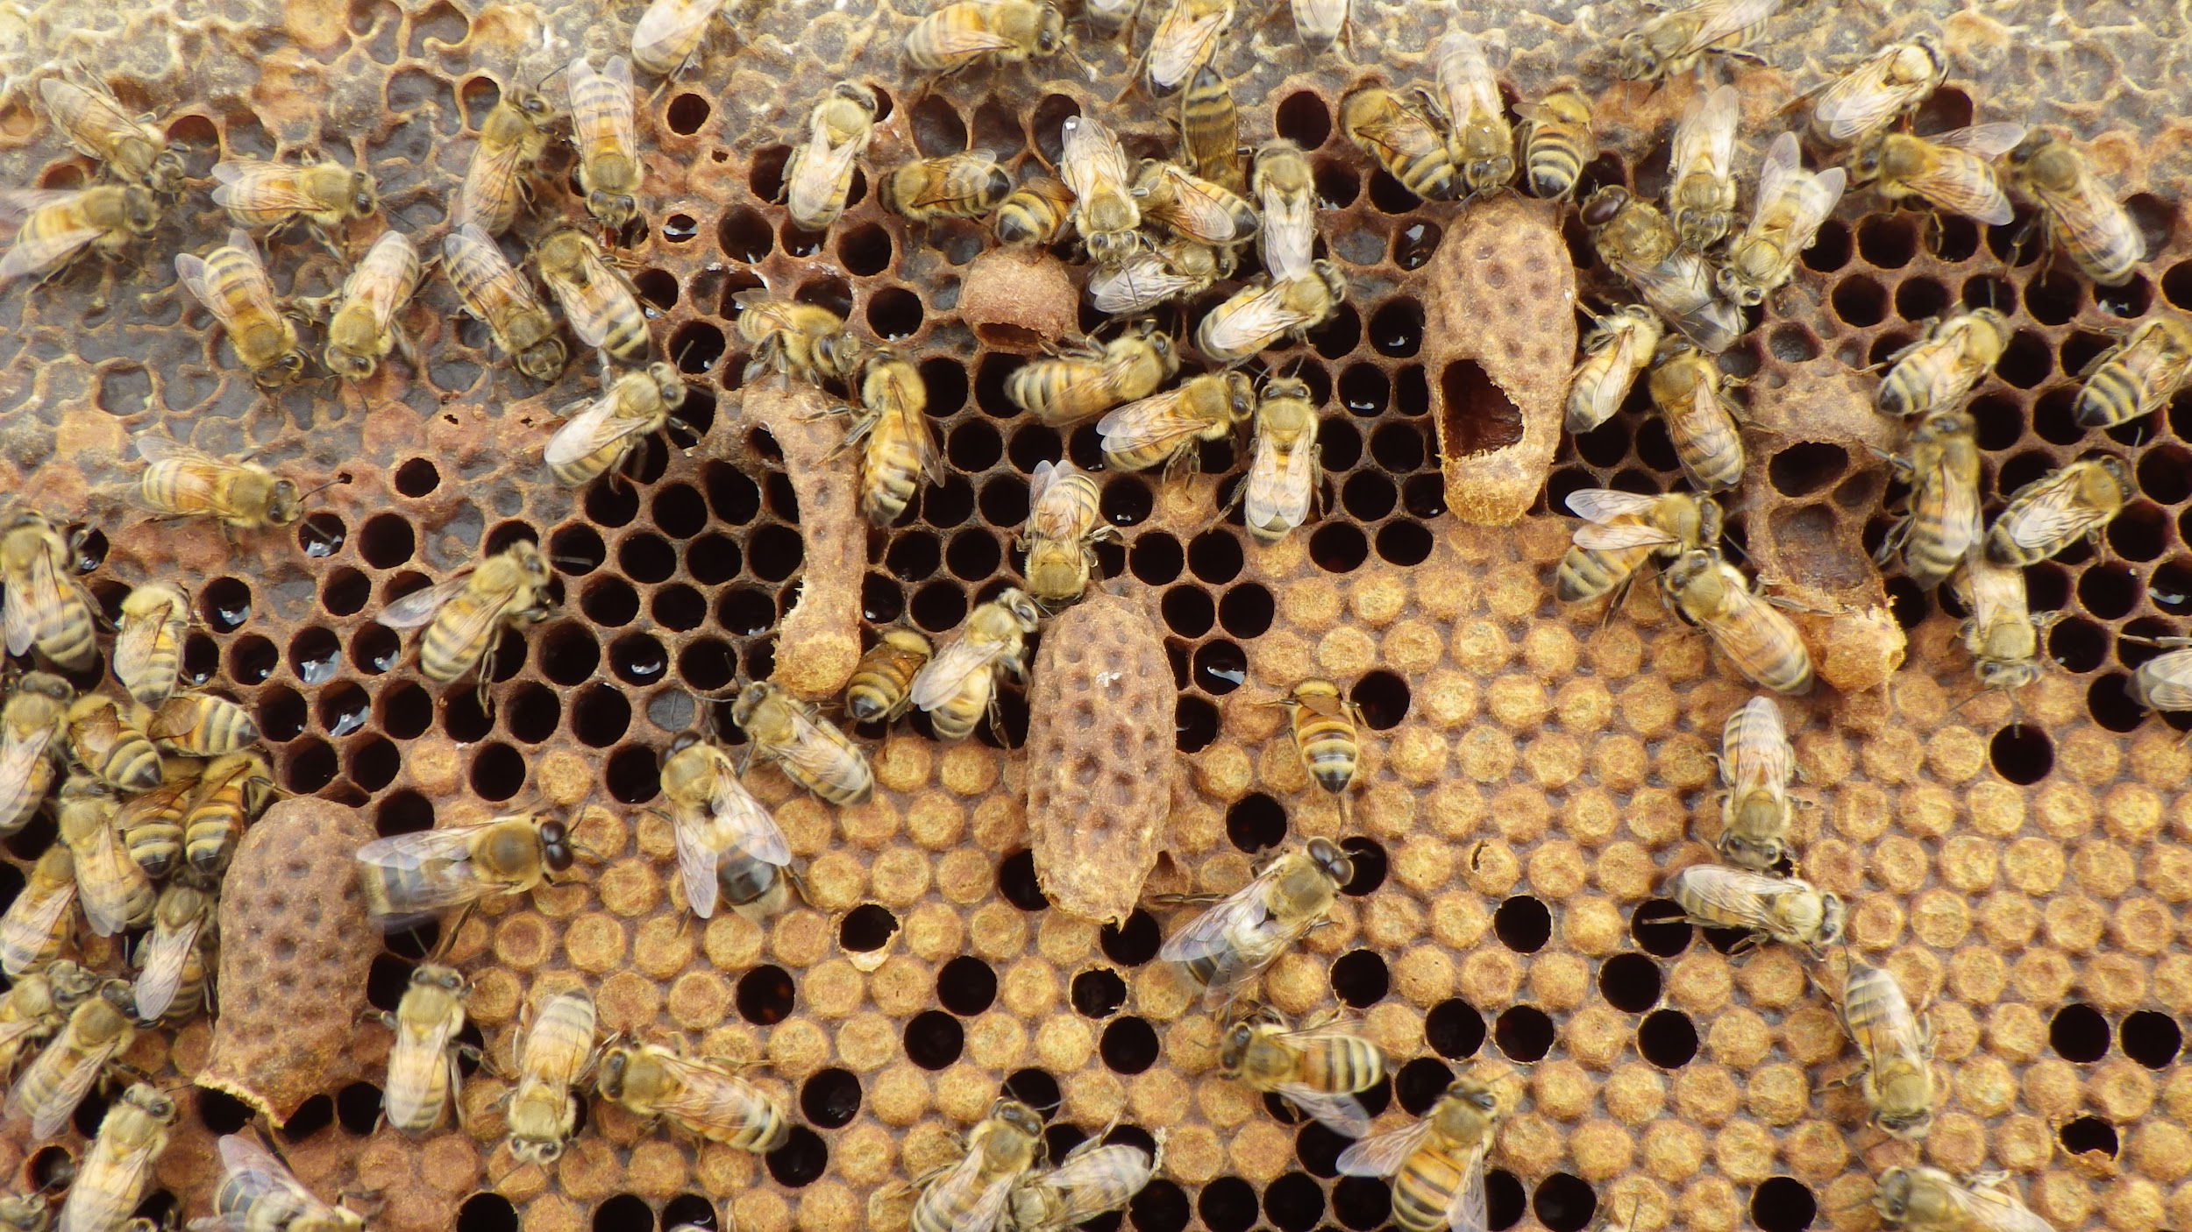
Swarm Biology:
Cell Identification

Slide 7
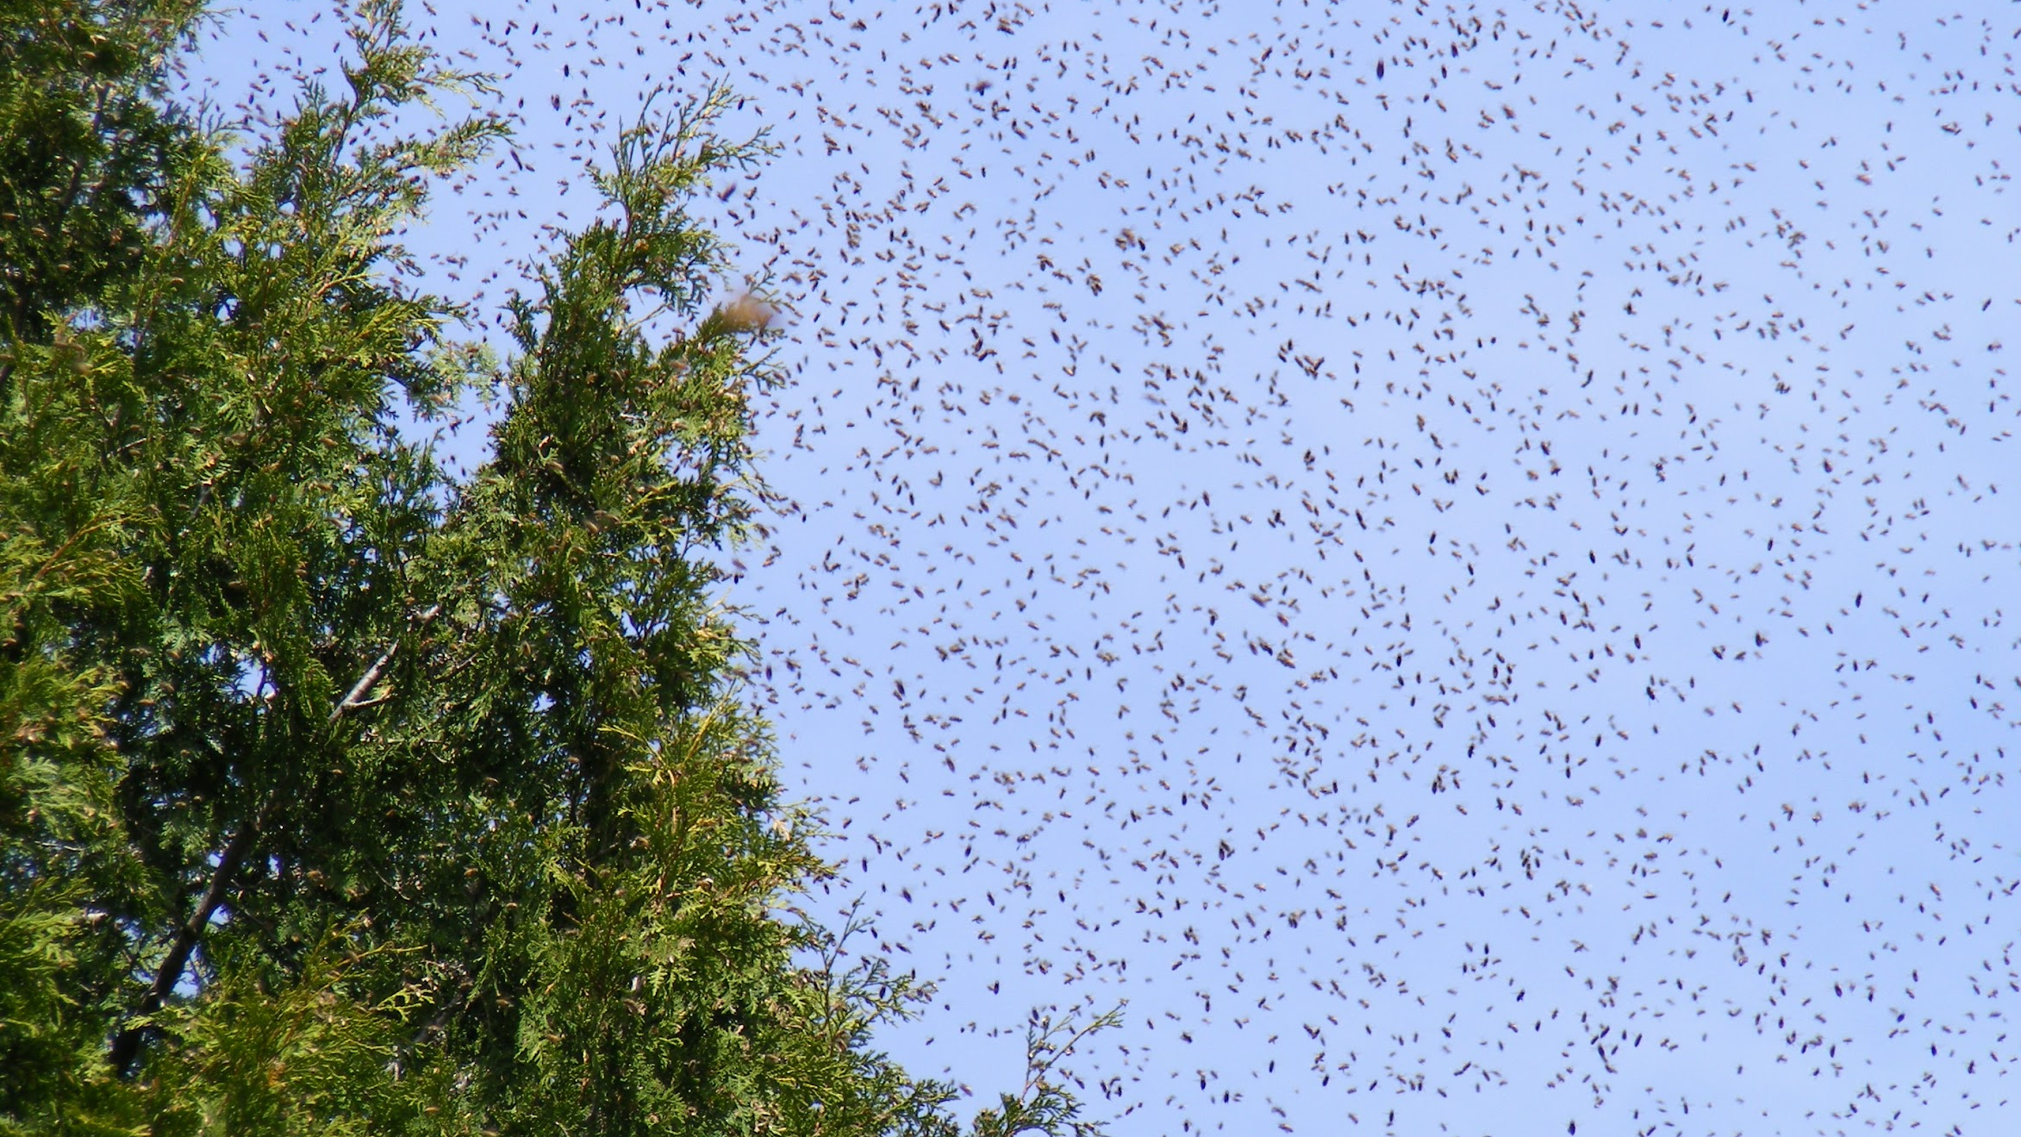
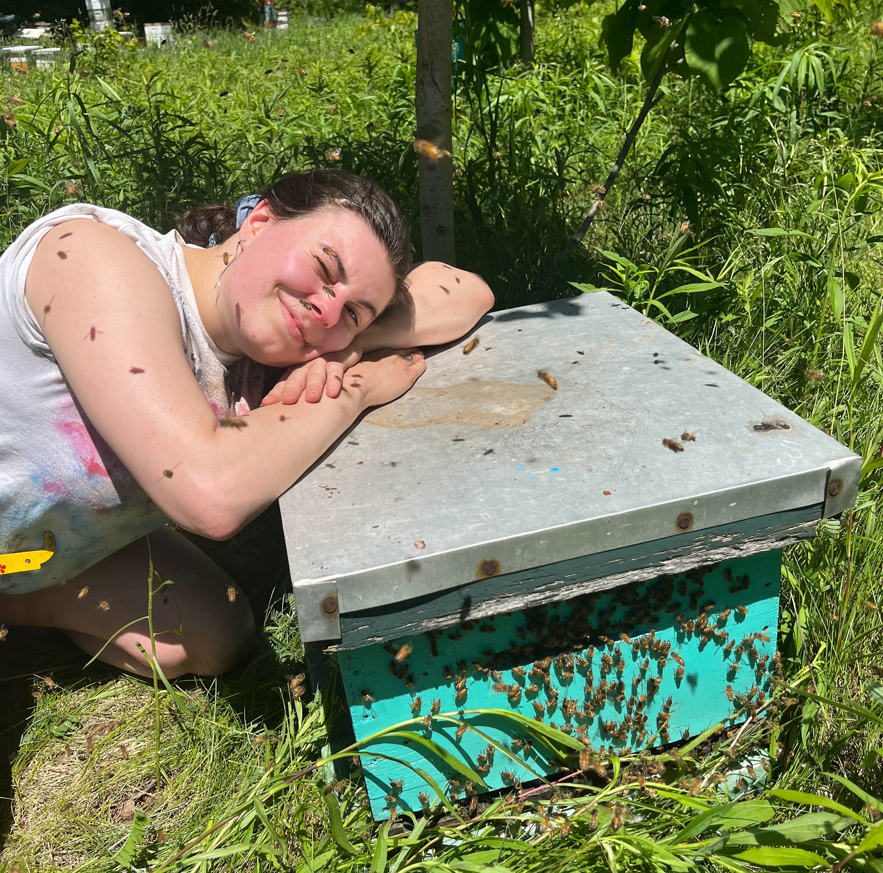
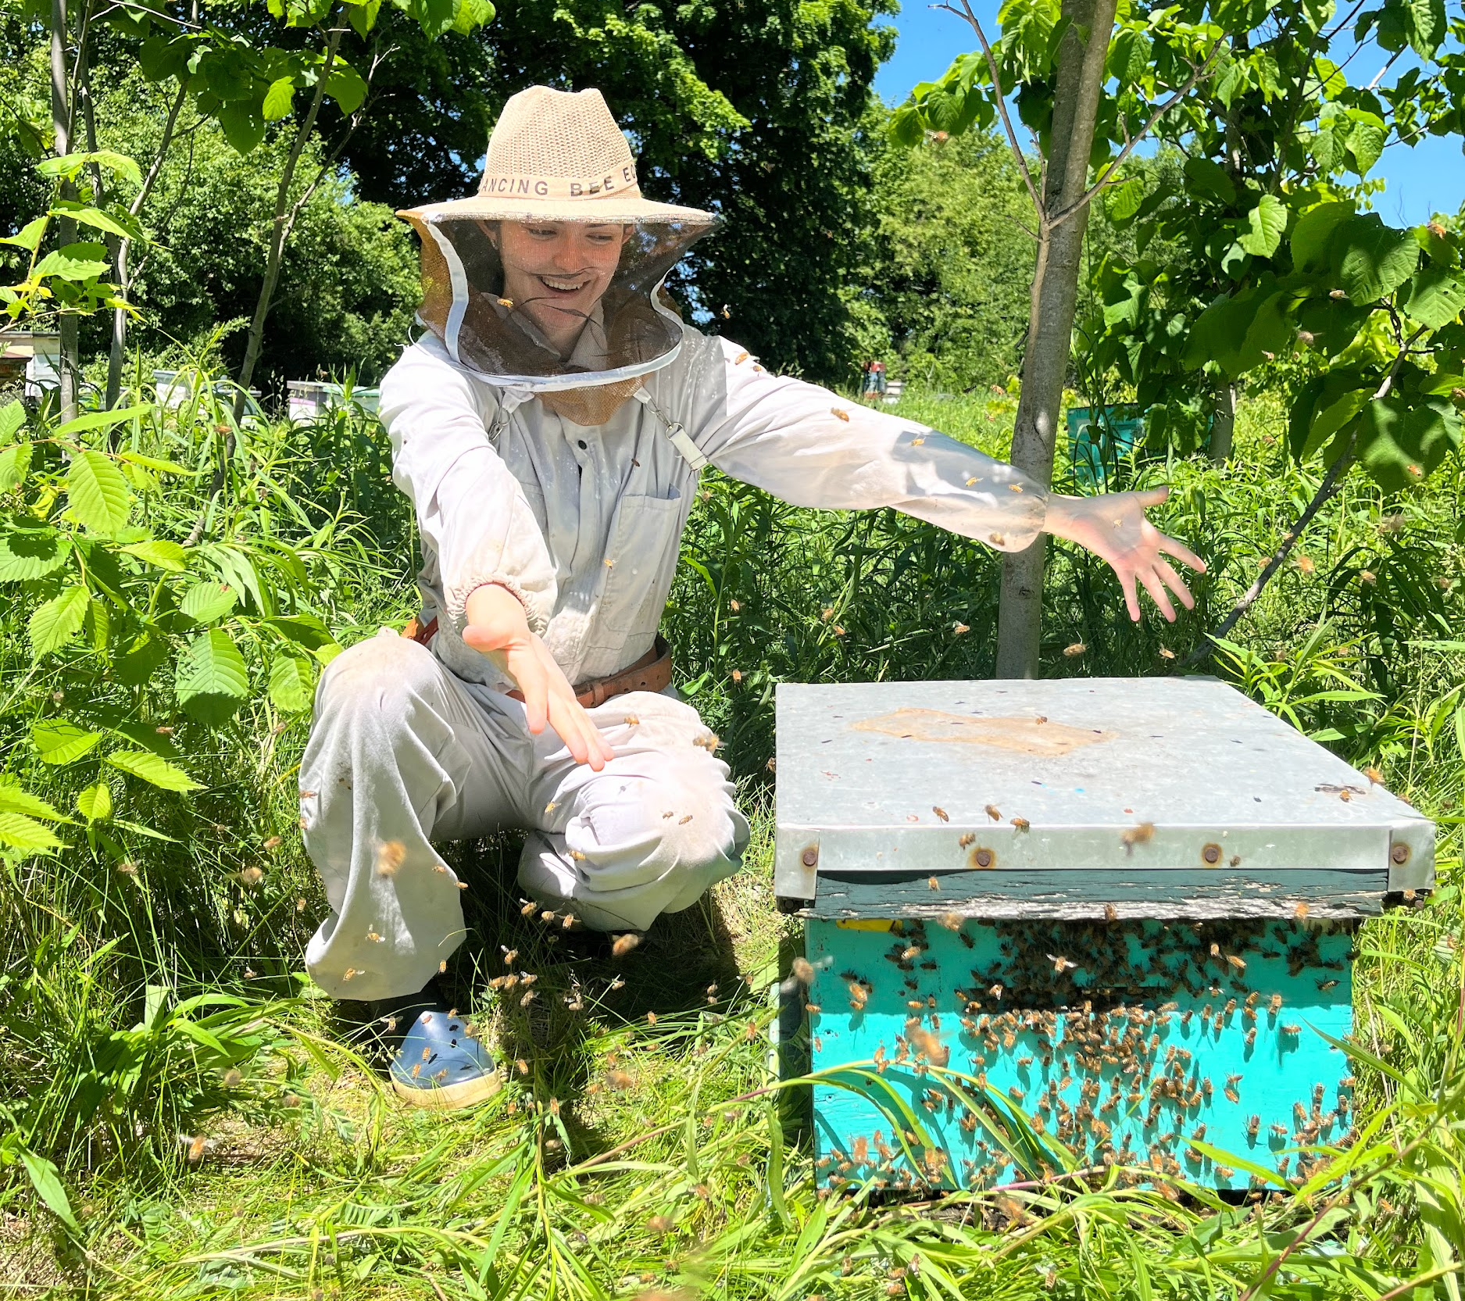
Swarm Mitigation
Adding Supers
Adding Brood Chambers
Splitting Colonies-
Nucing Colonies
Re-queening
Briefly Caging the queen
Clipping queens’ wings

Slide 8
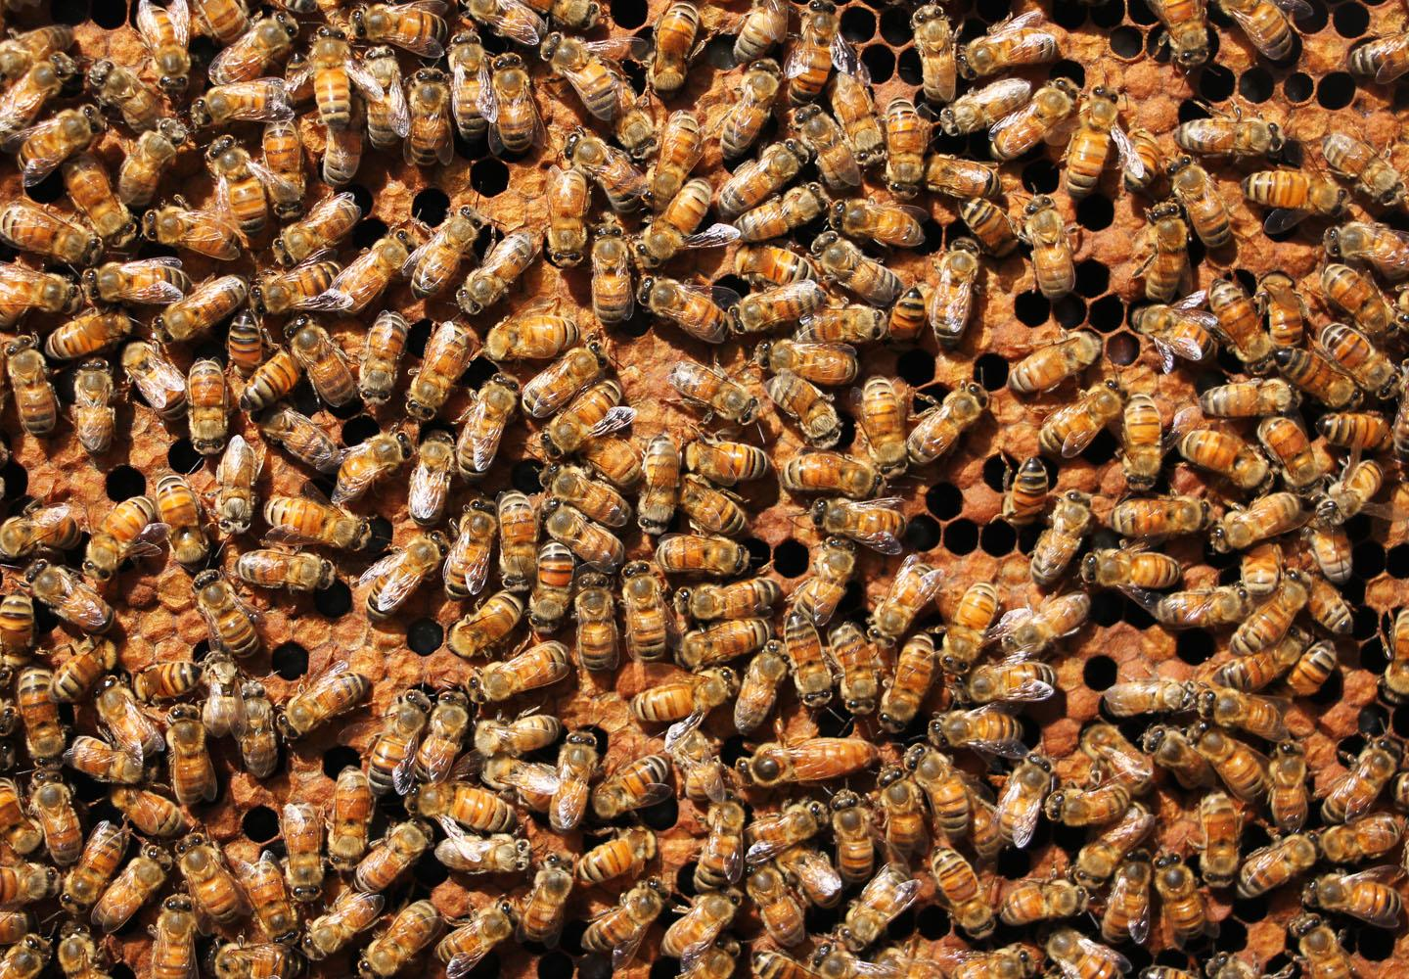
Splitting colonies For Swarm Prevention:
First Step: Queen Spotting

Slide 9
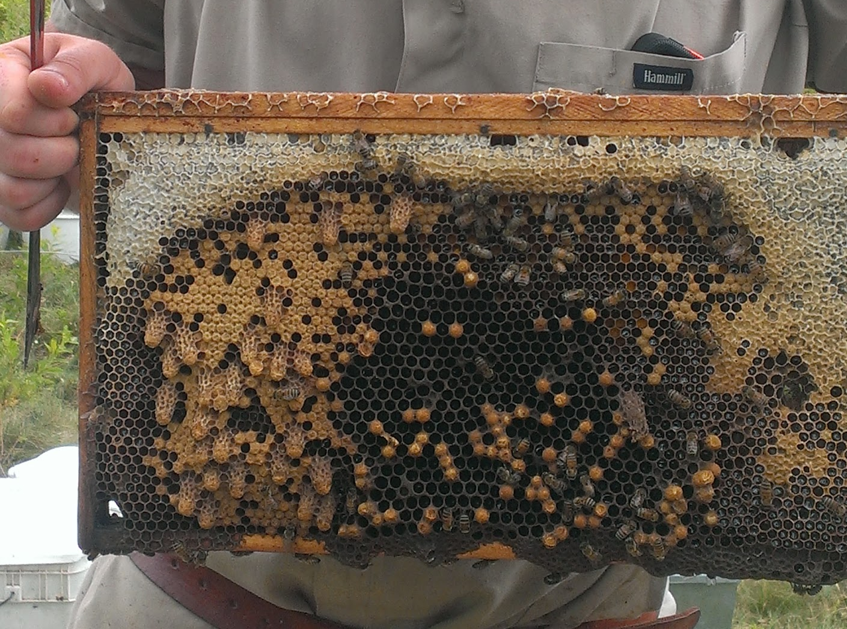
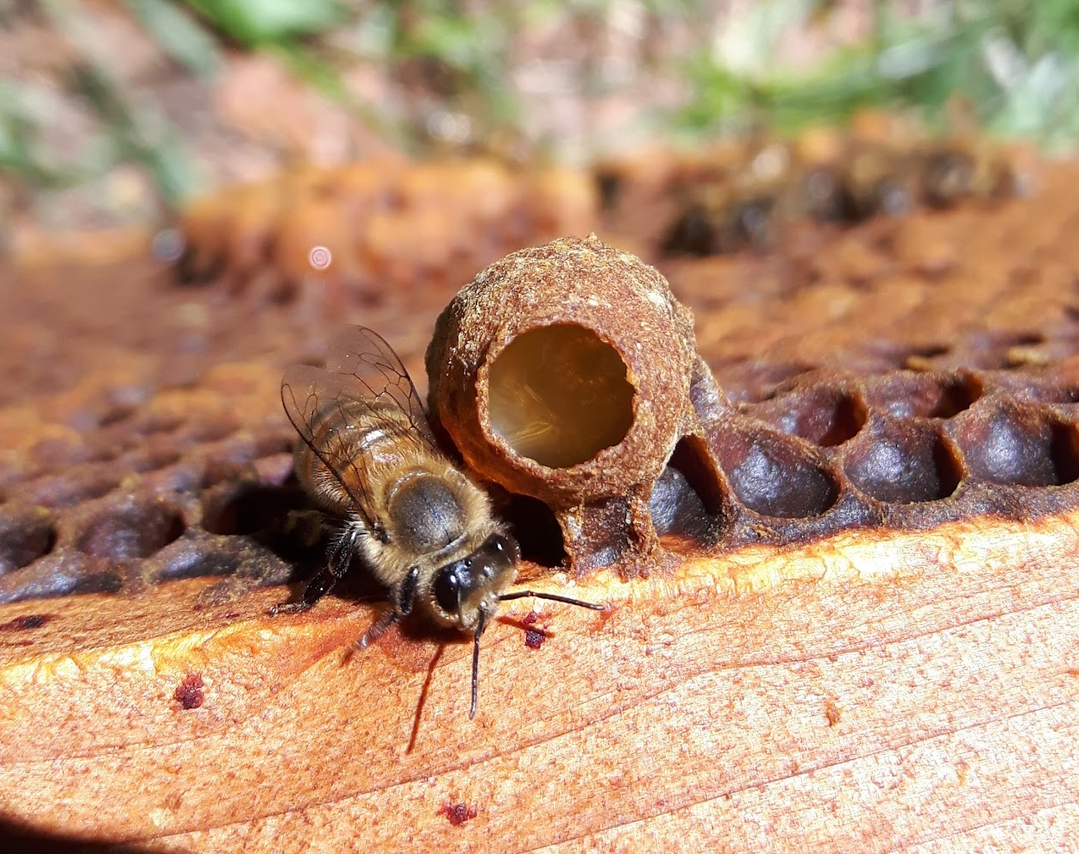
Splitting colonies For Swarm Prevention:
Second Step: Shaking Bees

Slide 10
Splitting colonies For Swarm Prevention:
Starting Points
Parent Colony:
Split:
Should receive mostly capped brood
Strong
Many bees for shaking
At least five frames of brood

Slide 11
Splitting colonies For Swarm Prevention:
Minimum Resources
Parent Colony:
Split:
Receives one foundation frame
Receives 2 drawn frames
Receives 3 brood frames from parent
Receives 3 drawn frames
Receives 4 foundation frame

Slide 12
Splitting colonies For Swarm Prevention:
Splitting Methods
Single box with queen search
Single box with no queen search
Double box with no queen search

Slide 13
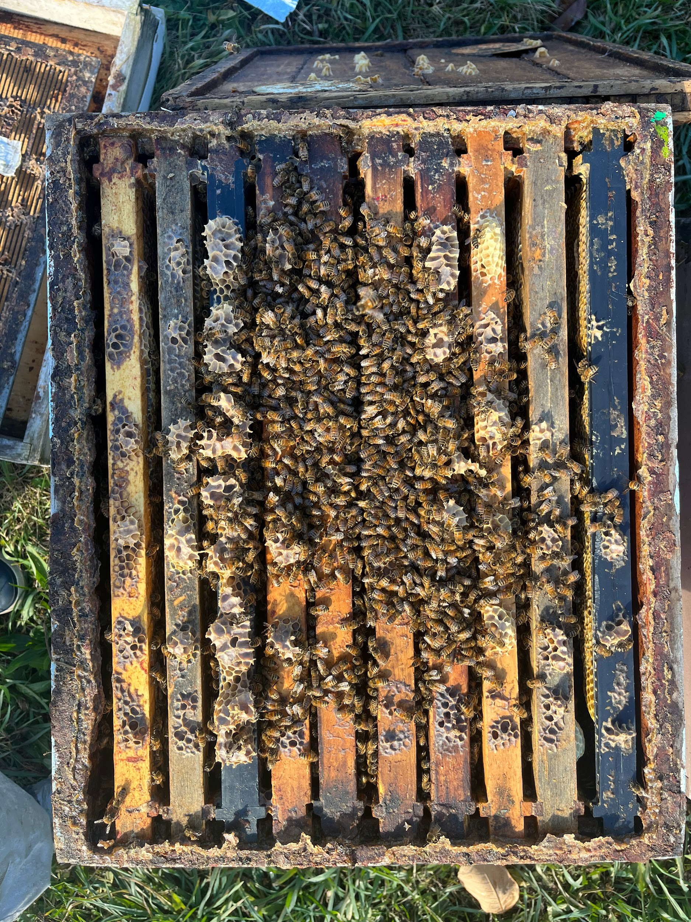
Splitting Methods:
Single Box. Queen Search
Parent Colony 👑
Split
honey
drawn/foundation
foundation
drawn/foundation
drawn
3 Brood frames
honey
honey
brood
brood
brood
brood
brood
brood
1 Feed frame
honey
honey
drawn
drawn
drawn
drawn
drawn/foundation

Slide 14
Splitting Methods:
Single Box. No Queen Search
Split
👑
Split
Queen Excluder
👑

Slide 15
Splitting Methods:
Double Box. No Queen Search
Queen Excluder
👑
1 Week
👑
Split

Slide 16
Pulling Nucs For Swarm Prevention:
Making a Nuc
Parent Colony
Nuc 👑
drawn
drawn/foundation
drawn
brood
honey
brood
brood
honey
brood
brood
brood
honey
foundation
honey

