Slide 1
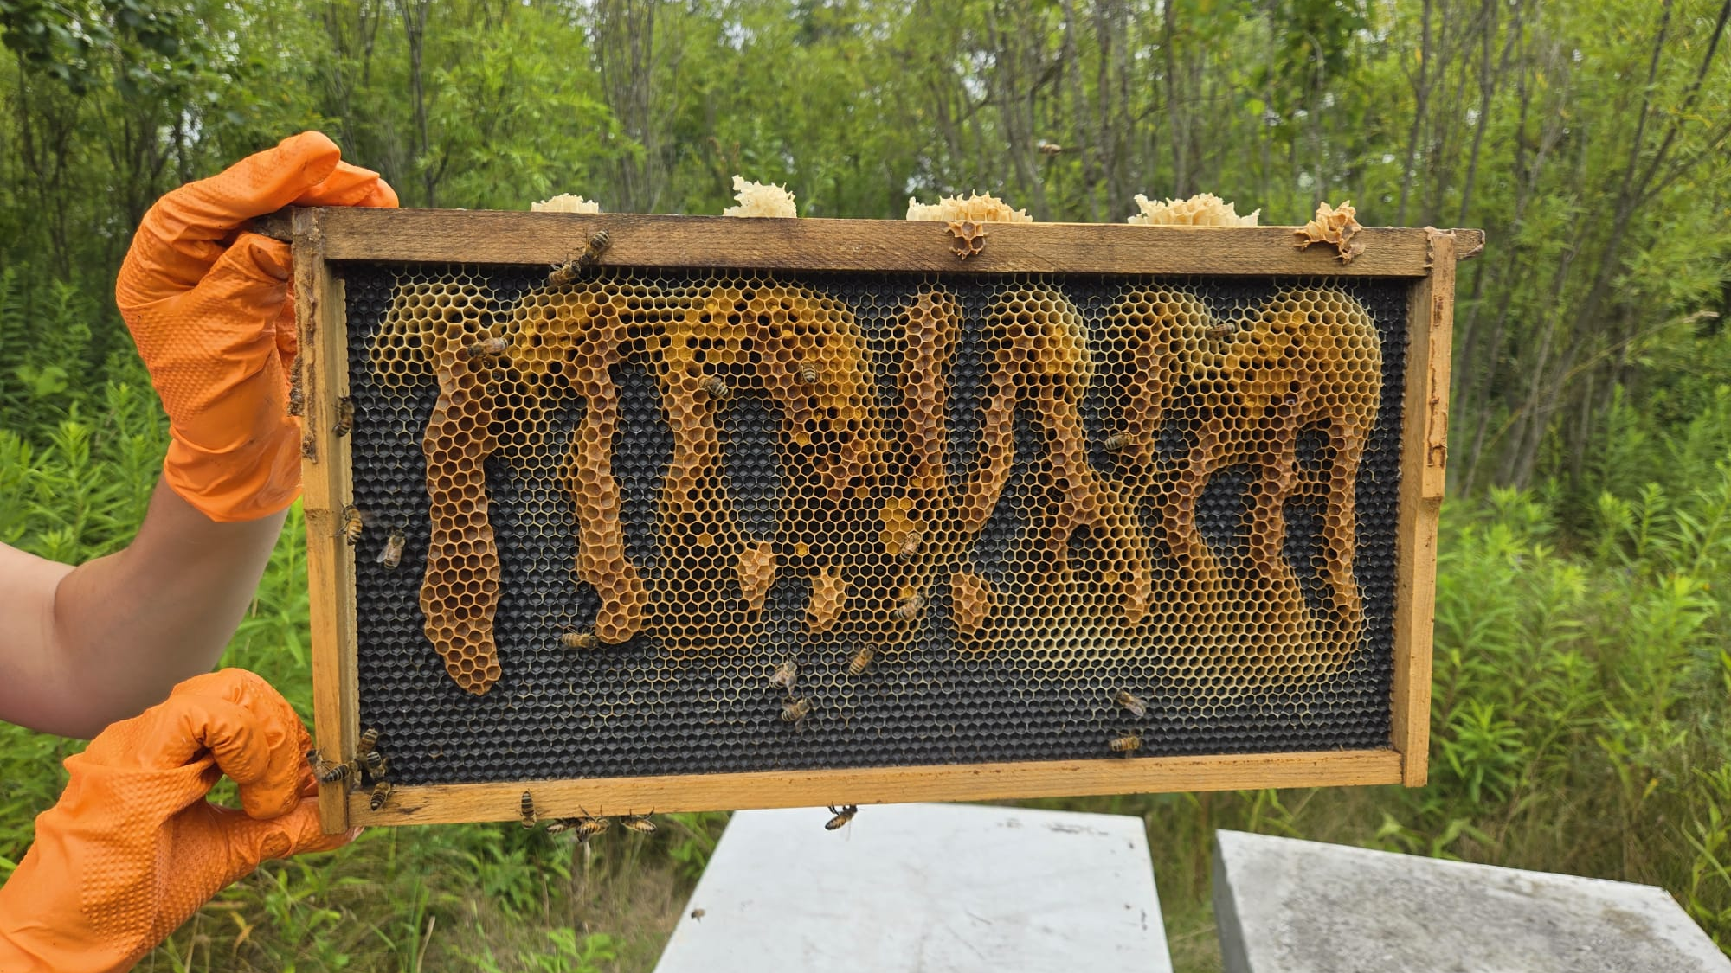
Splitting Colonies
To Prevent Swarms

Slide 2
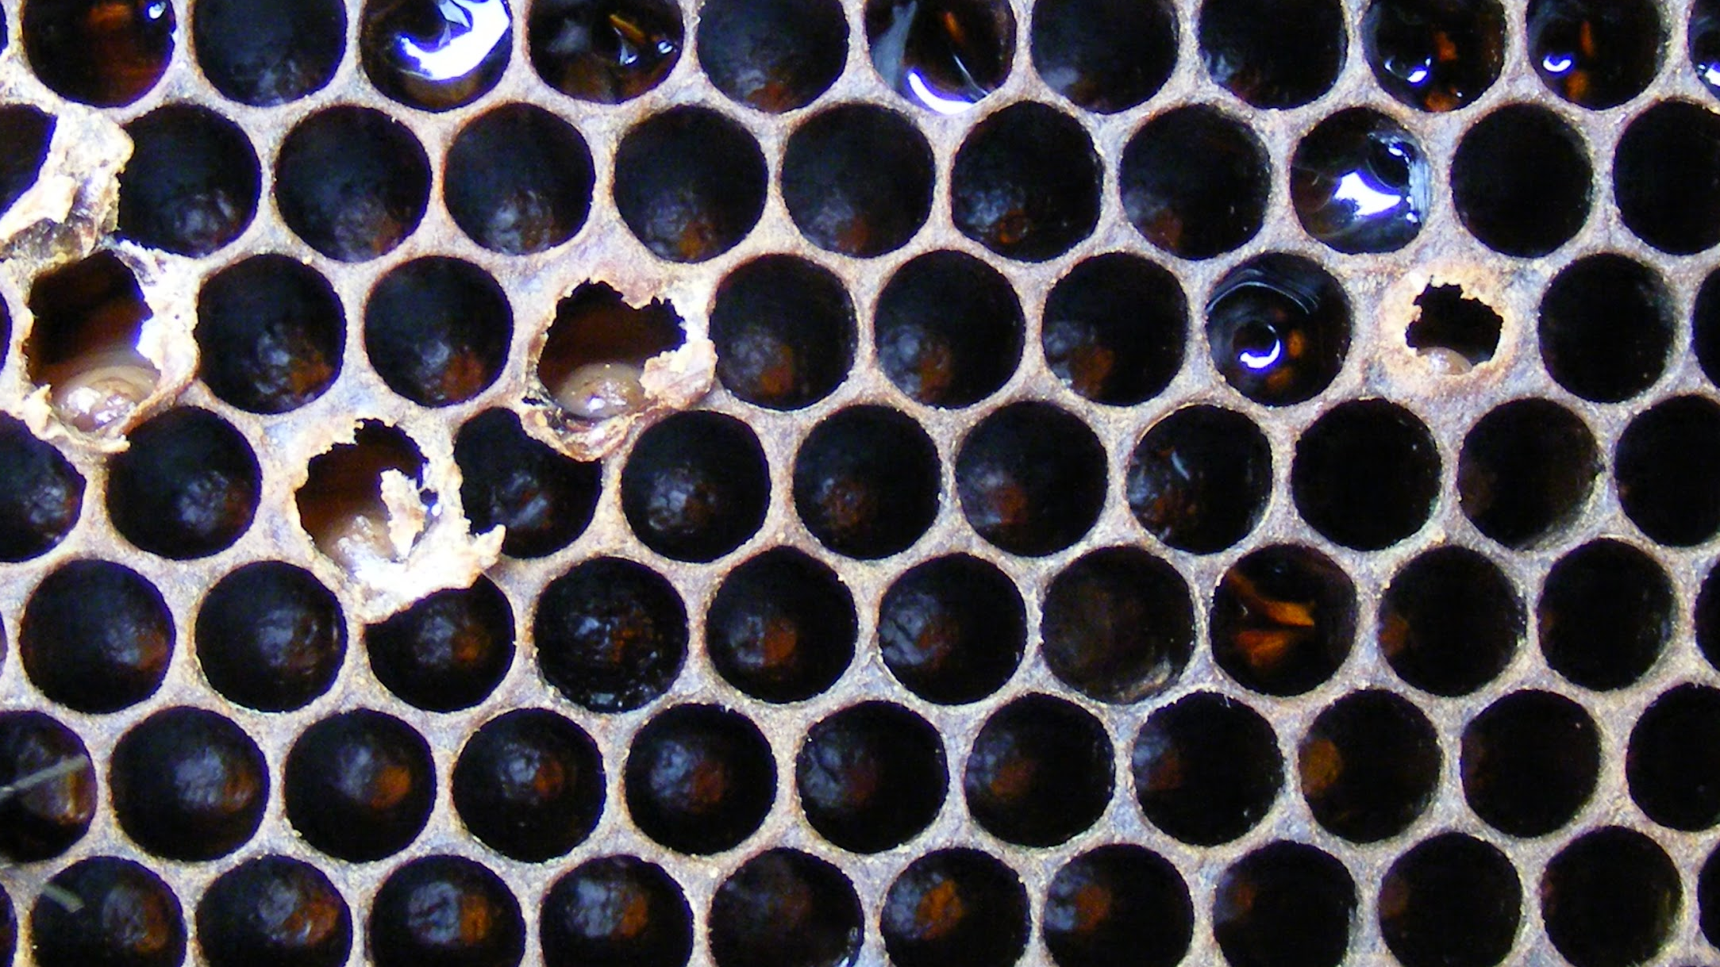
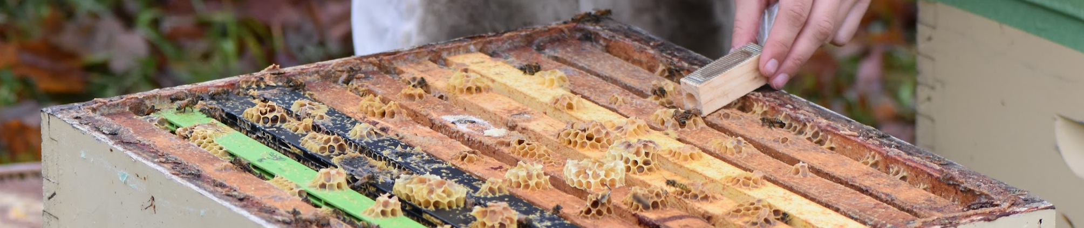
Queen Introductions
General Guidelines
24 hour queenless period
Add queen/cell in centre of the brood chamber
Avoid using too much smoke
Double check for queen cells

Slide 3
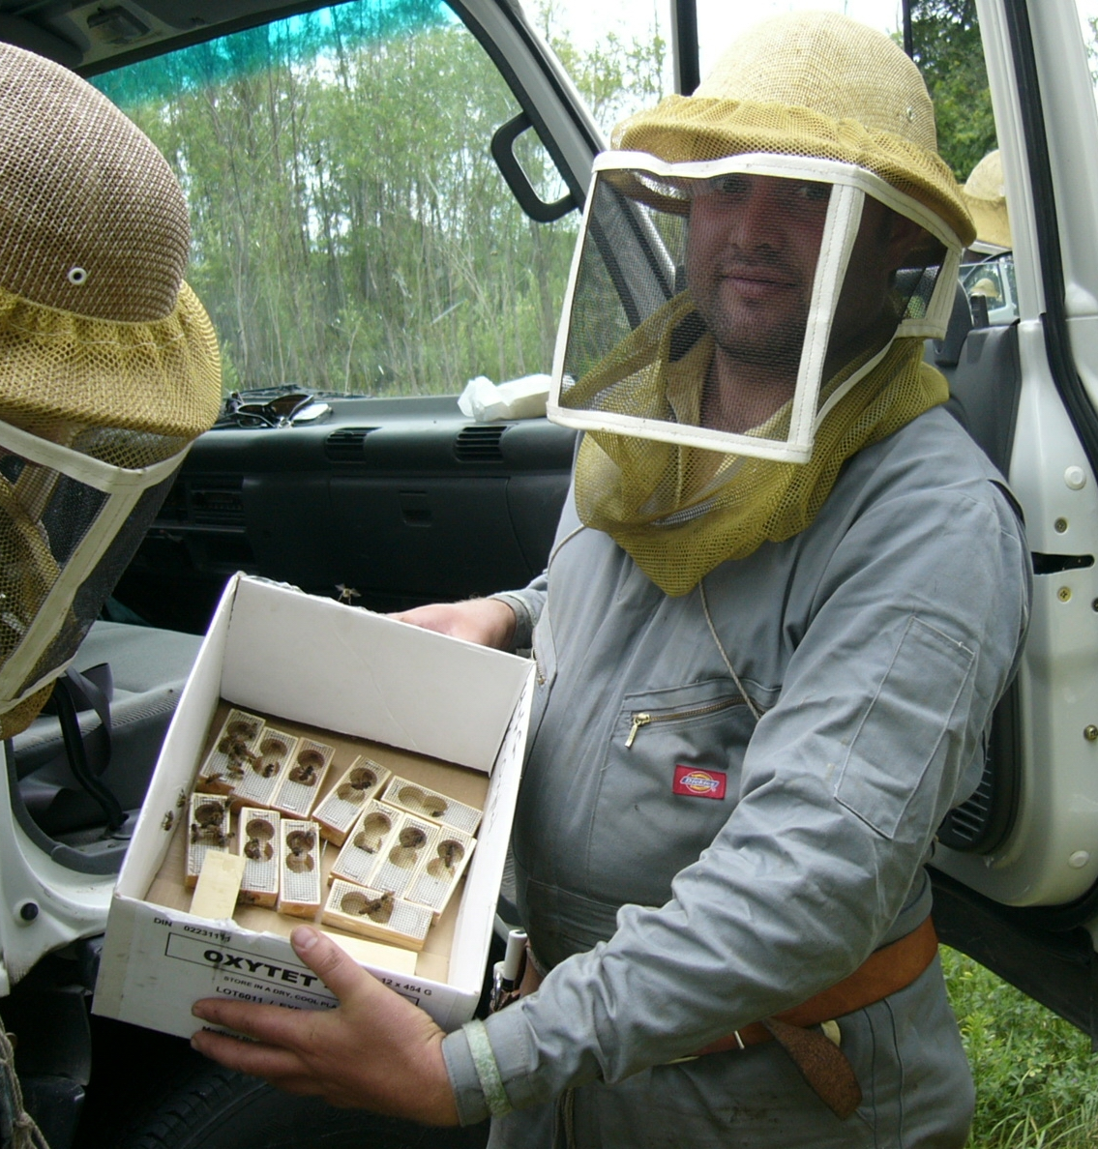
Queen Introductions
Mated Queens
Screen facing down
Candy plug directed downwards
In between frames/bars
Check 4-7 days after introduction

Slide 4
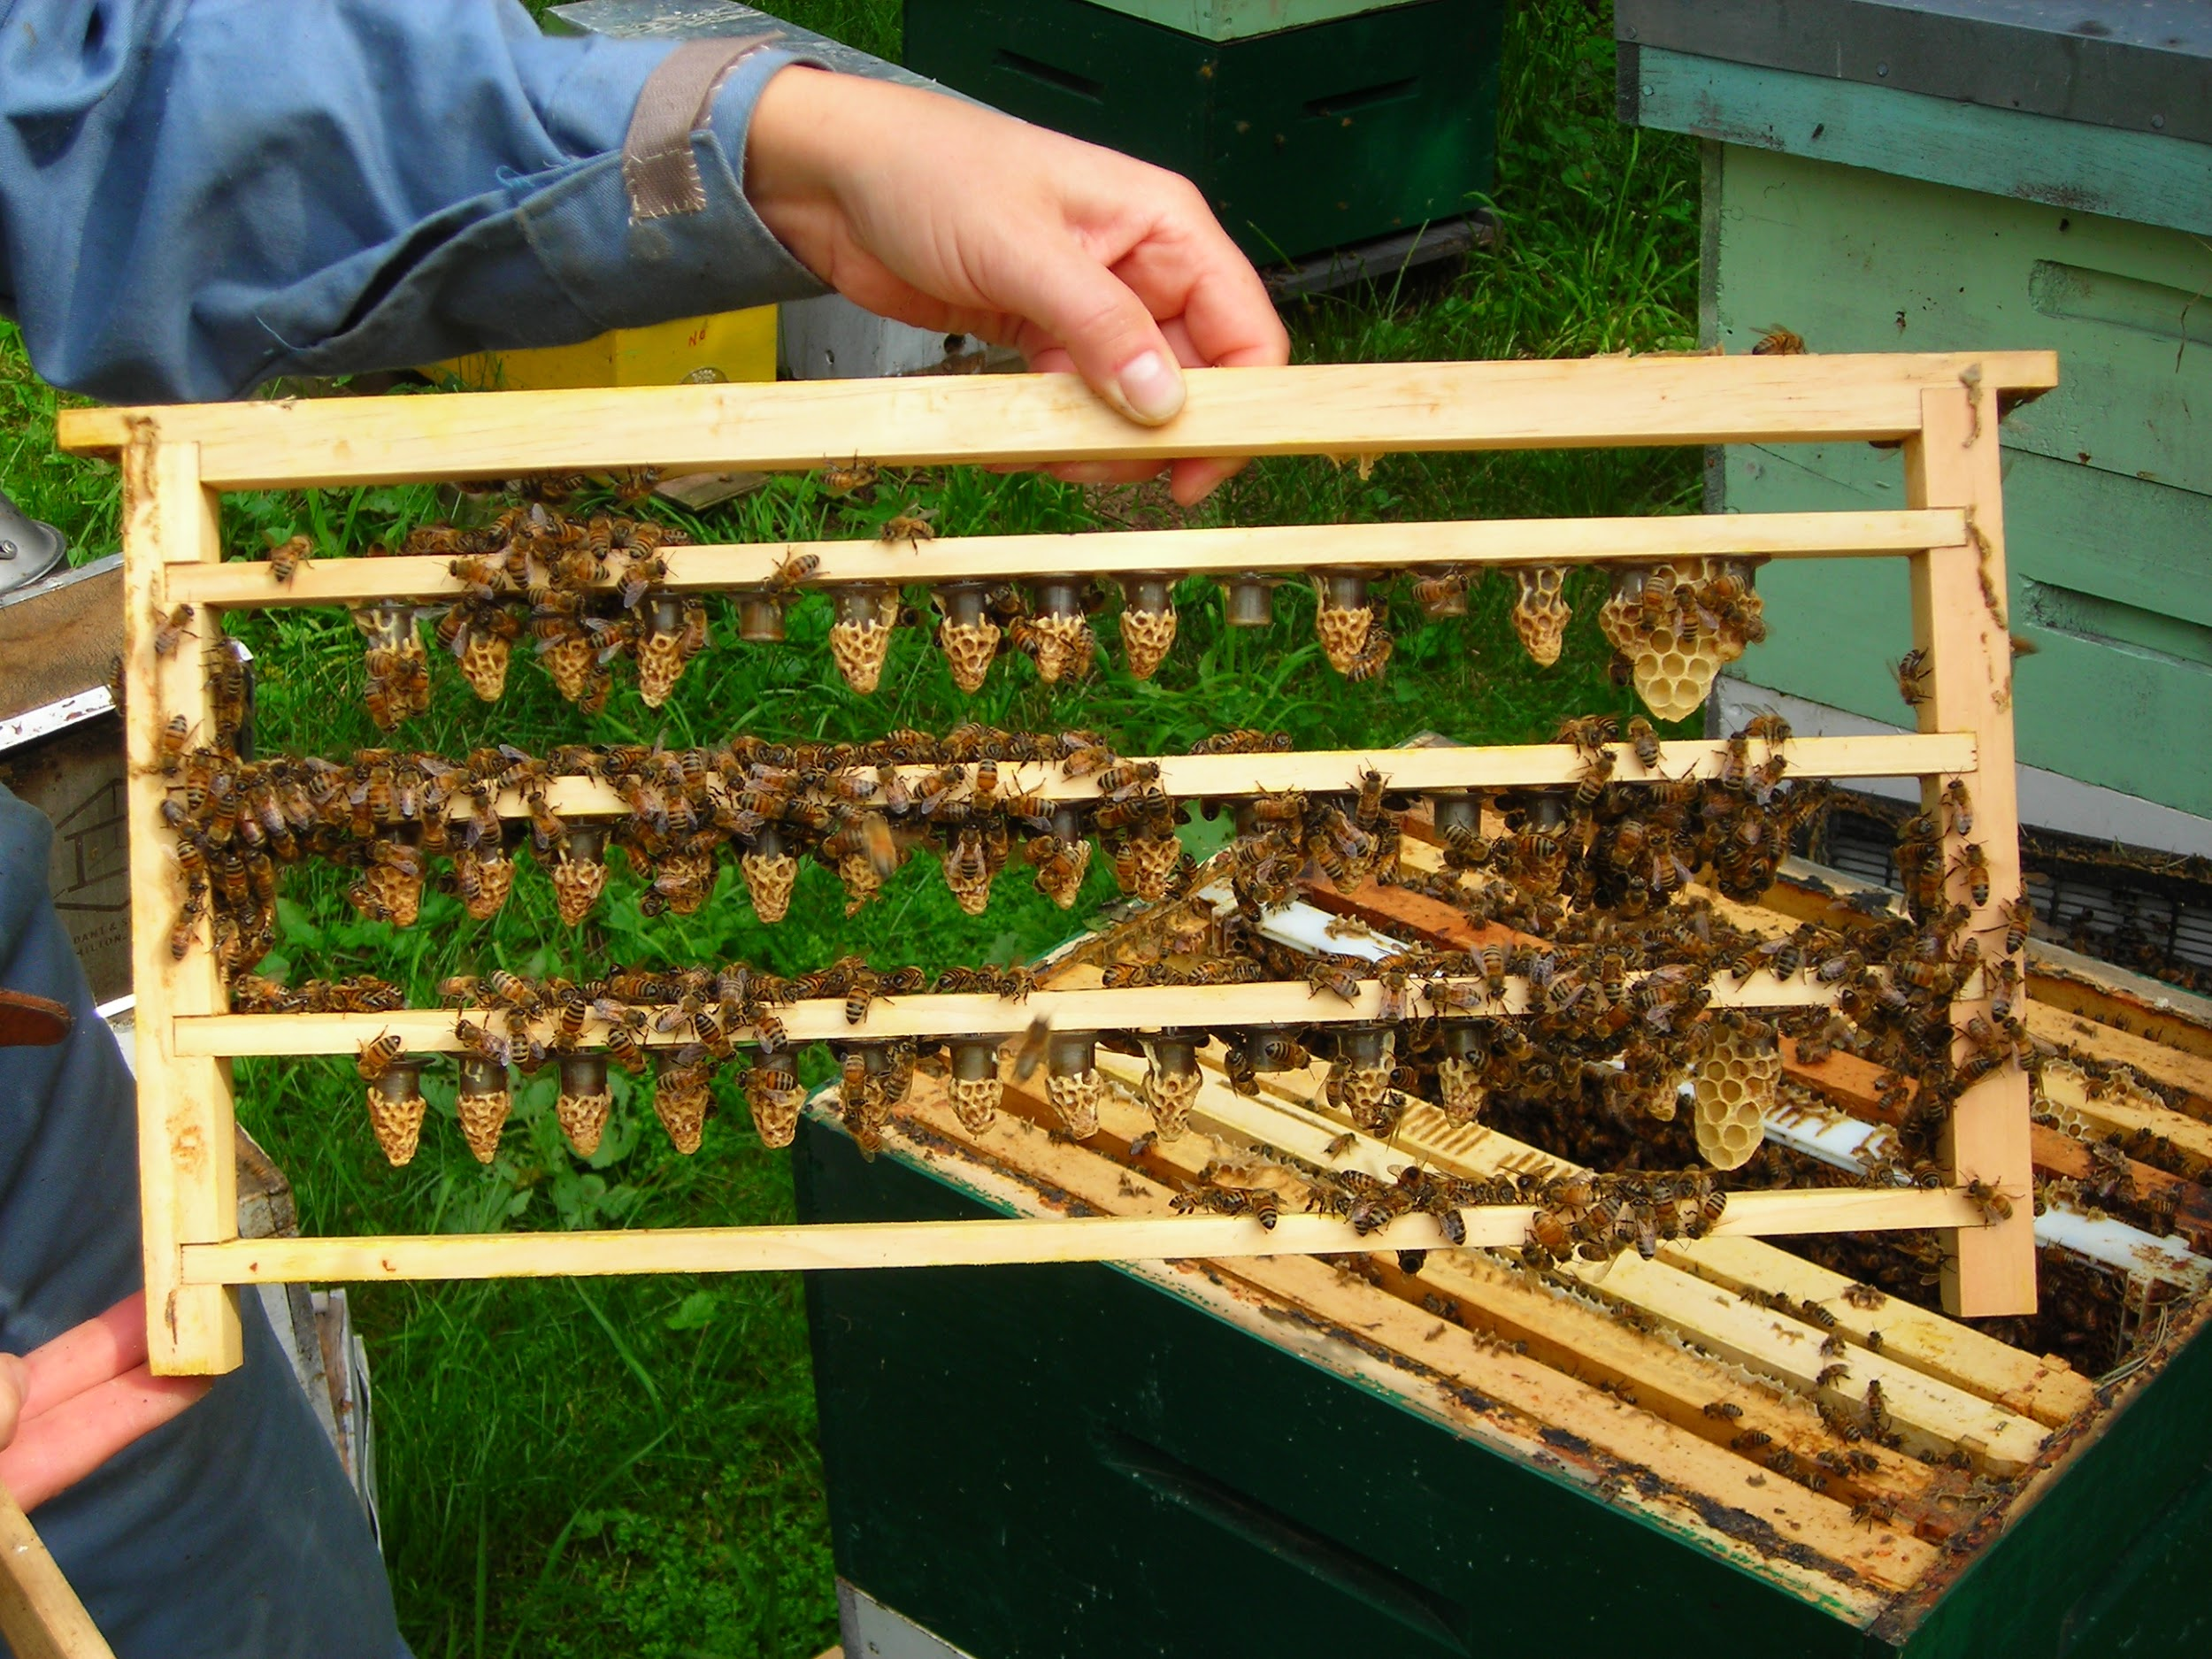
Queen Introductions
Queen Cells
Cells always placed upright
Place on top of bars/place in frame
Check 14 days after introduction

Slide 5
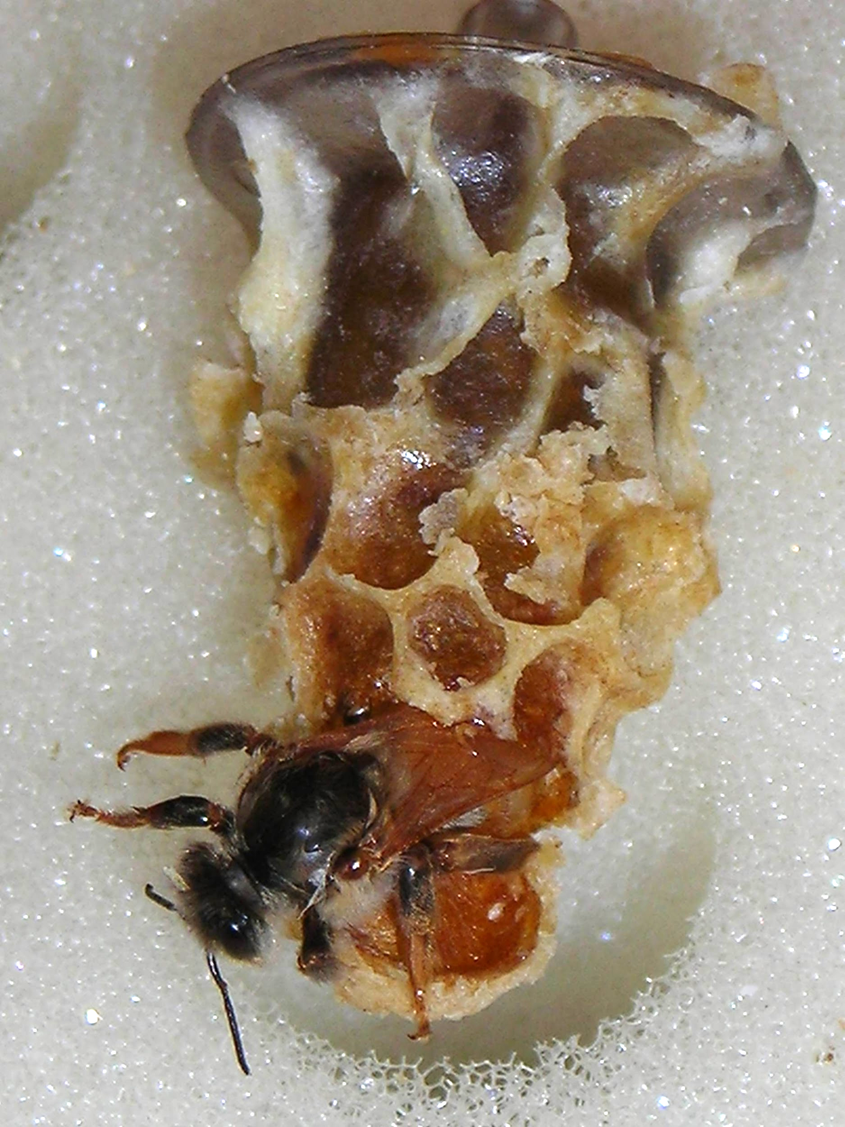
Queen Introductions
Virgin Queens
No open brood
Add similar to a caged mated queen
Check 14 days after introduction

