Slide 1

CANADIAN HONEY COUNCIL
WWW.HONEYCOUNCIL.CA
SERVING BEEKEEPERS SINCE 1940

Slide 2
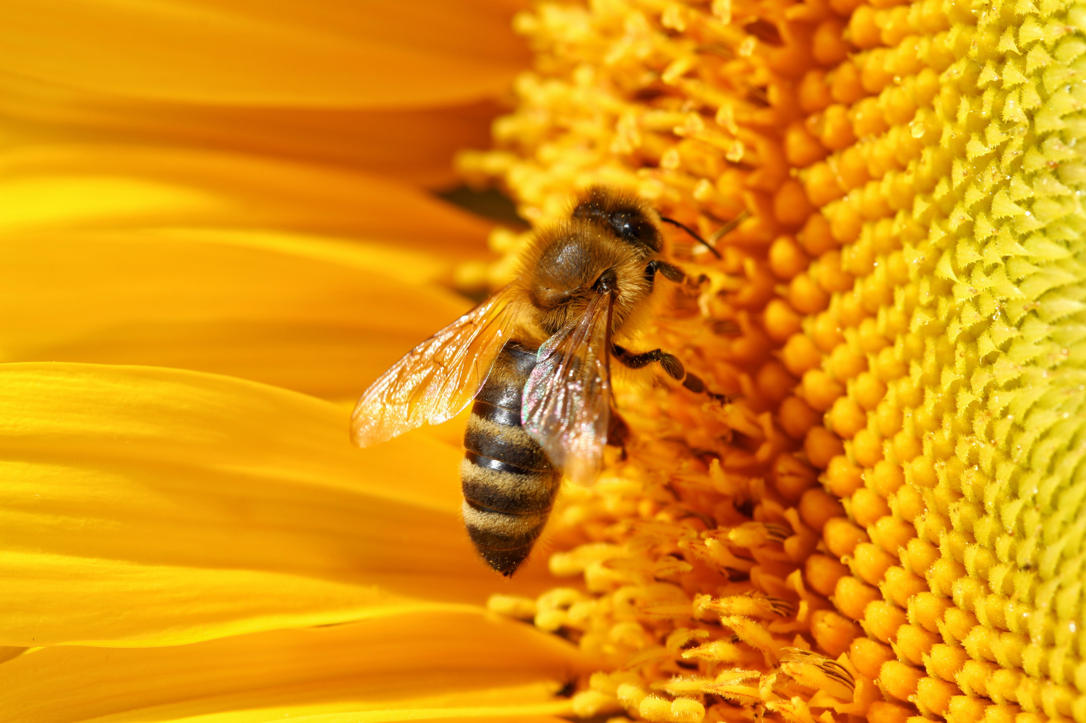
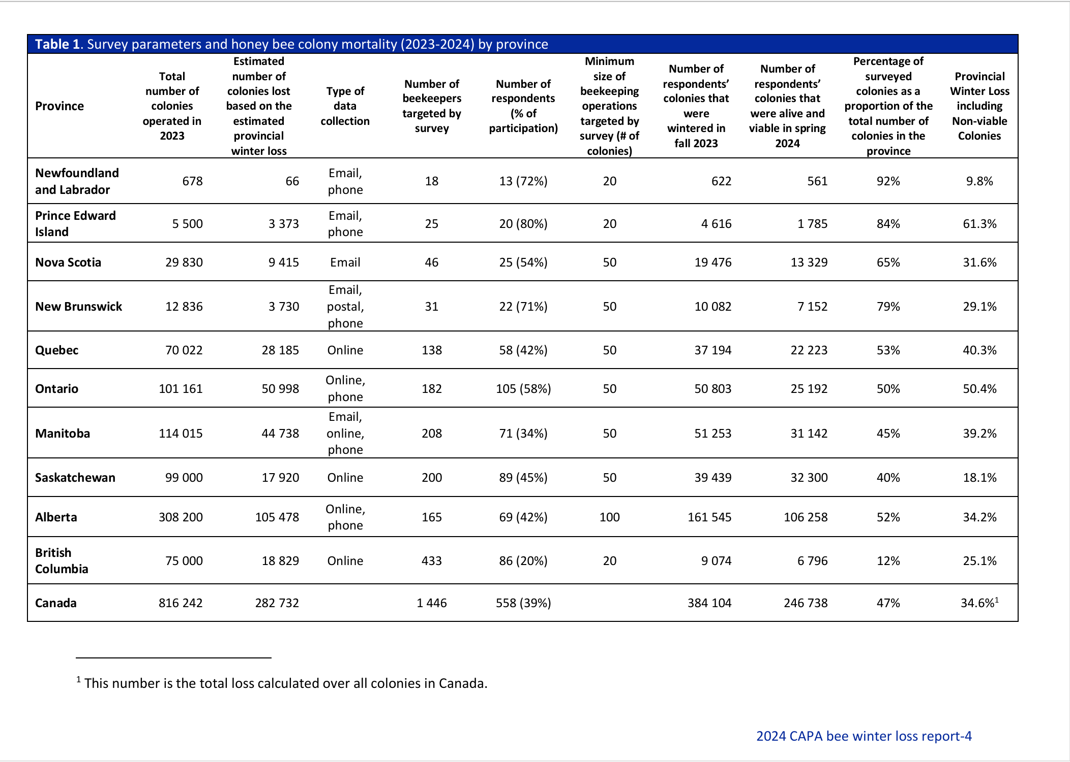

Colony Mortality

Slide 3
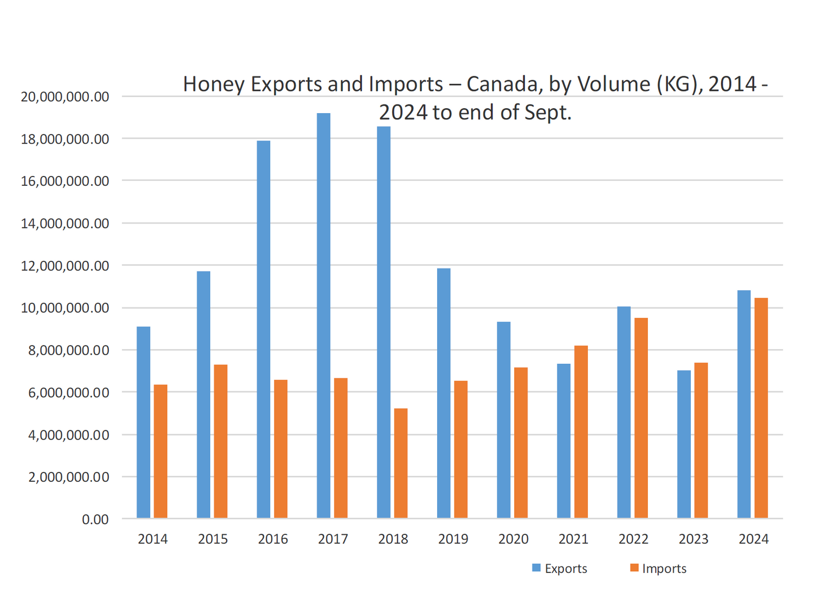
National Statistical Trends , 2024 - Stephen Page, Sector Specialist, Agriculture and Agri-Food Canada

Slide 4
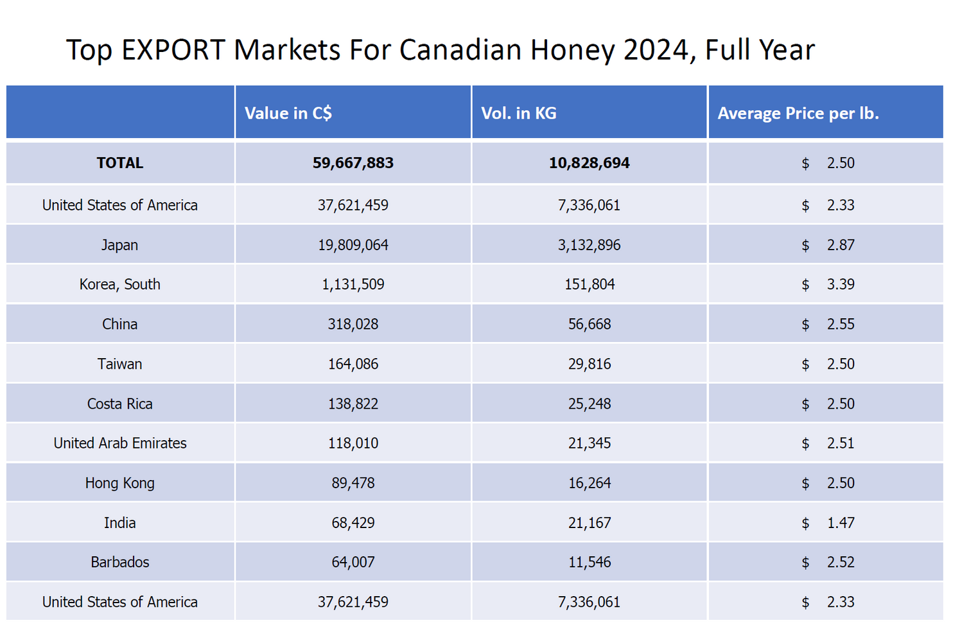
National Statistical Trends , 2024 - Stephen Page, Sector Specialist, Agriculture and Agri-Food Canada

Slide 5
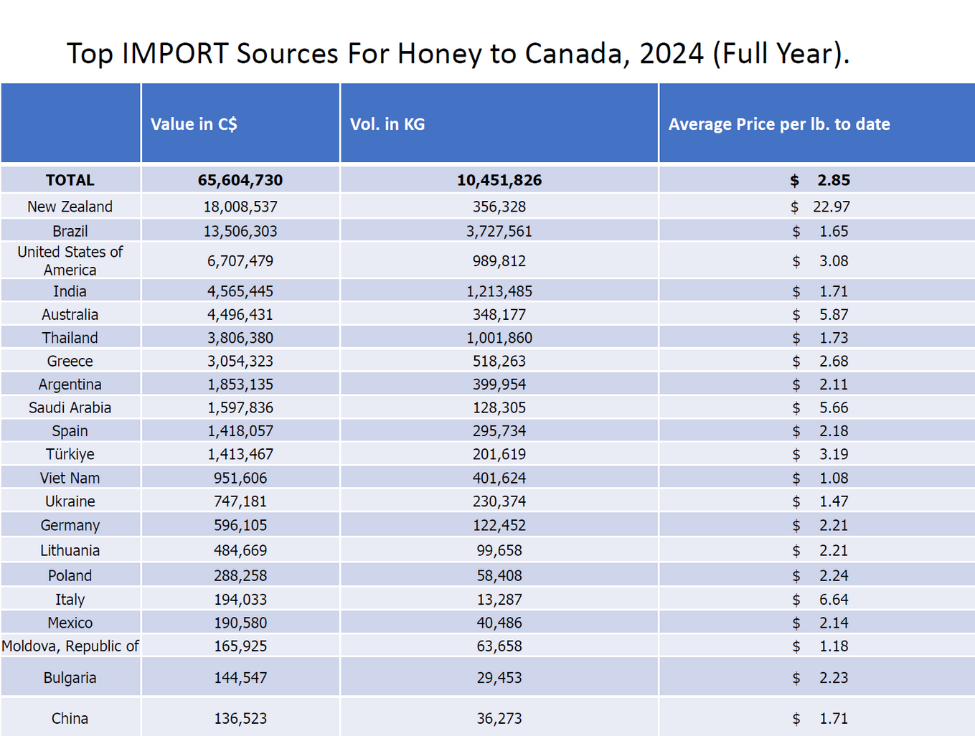
National Statistical Trends , 2024 - Stephen Page, Sector Specialist, Agriculture and Agri-Food Canada

Slide 6
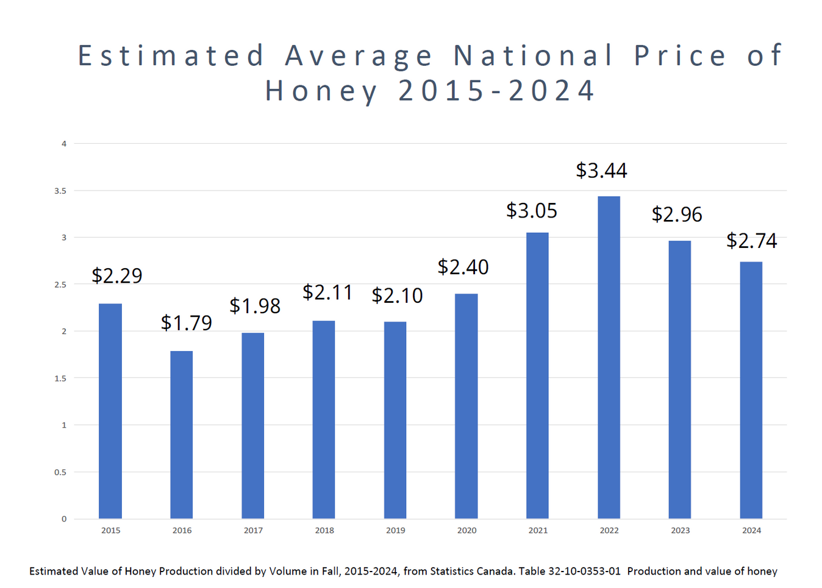
National Statistical Trends , 2024 - Stephen Page, Sector Specialist, Agriculture and Agri-Food Canada

Slide 7
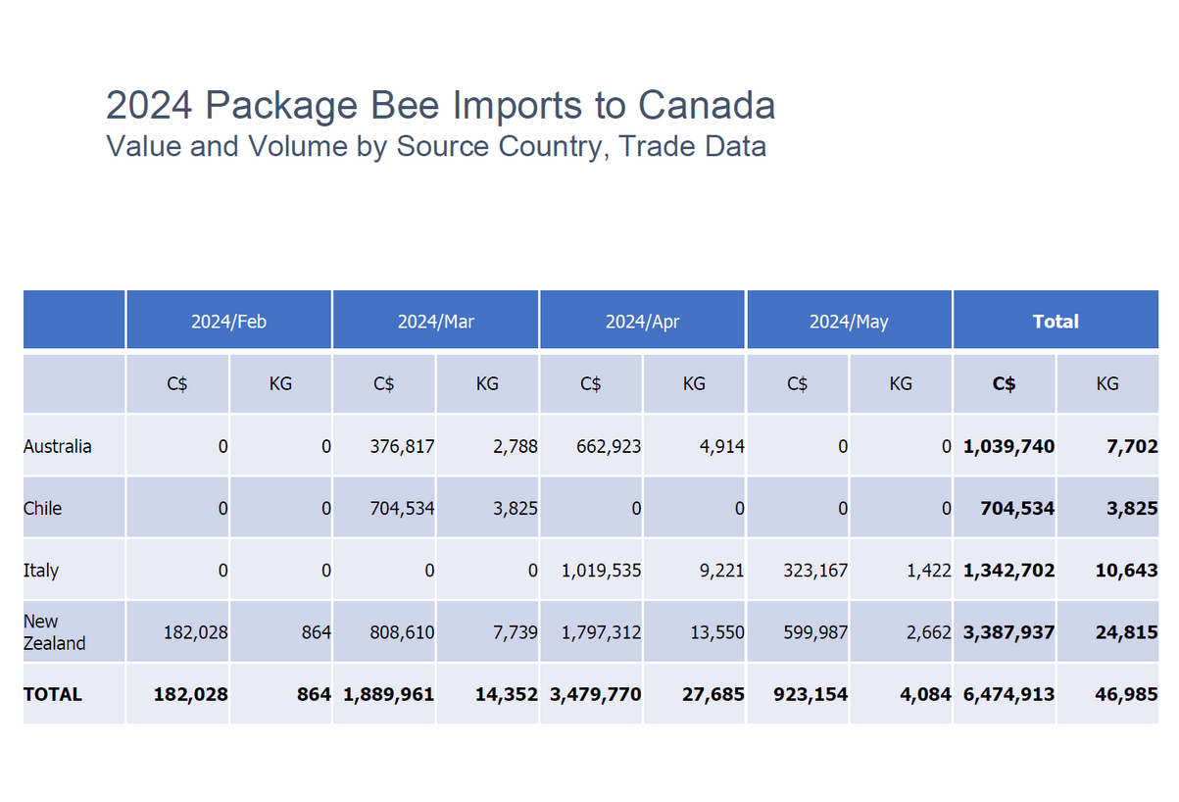
National Statistical Trends , 2024 - Stephen Page, Sector Specialist, Agriculture and Agri-Food Canada

Slide 8
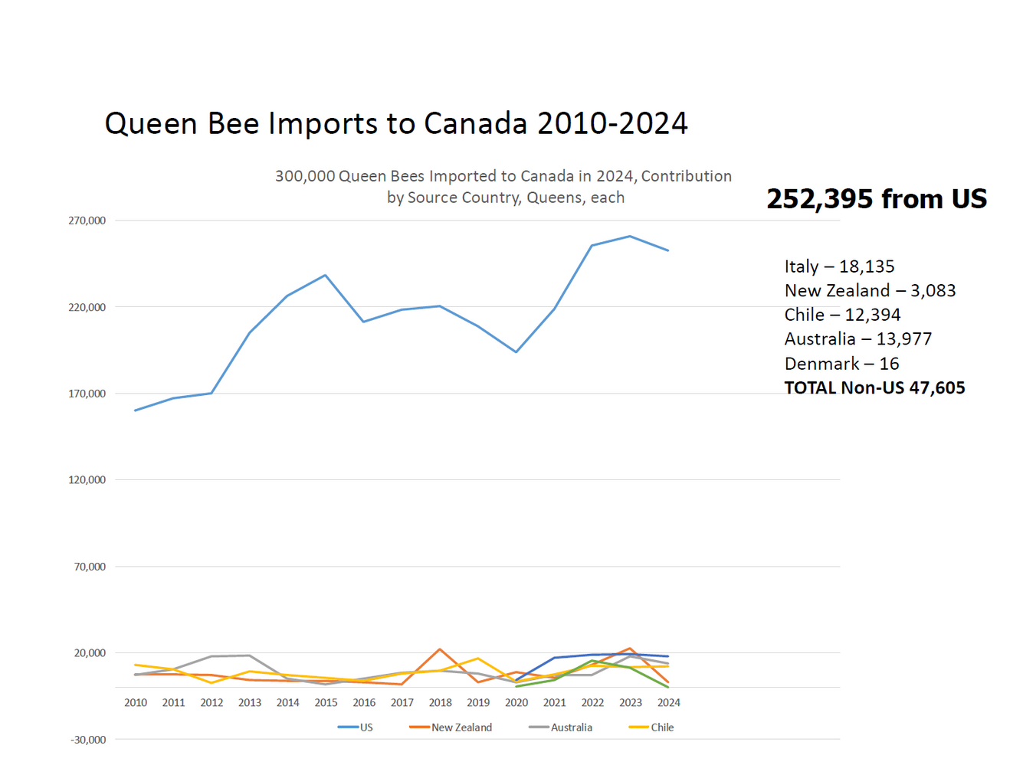
National Statistical Trends , 2024 - Stephen Page, Sector Specialist, Agriculture and Agri-Food Canada

Slide 9
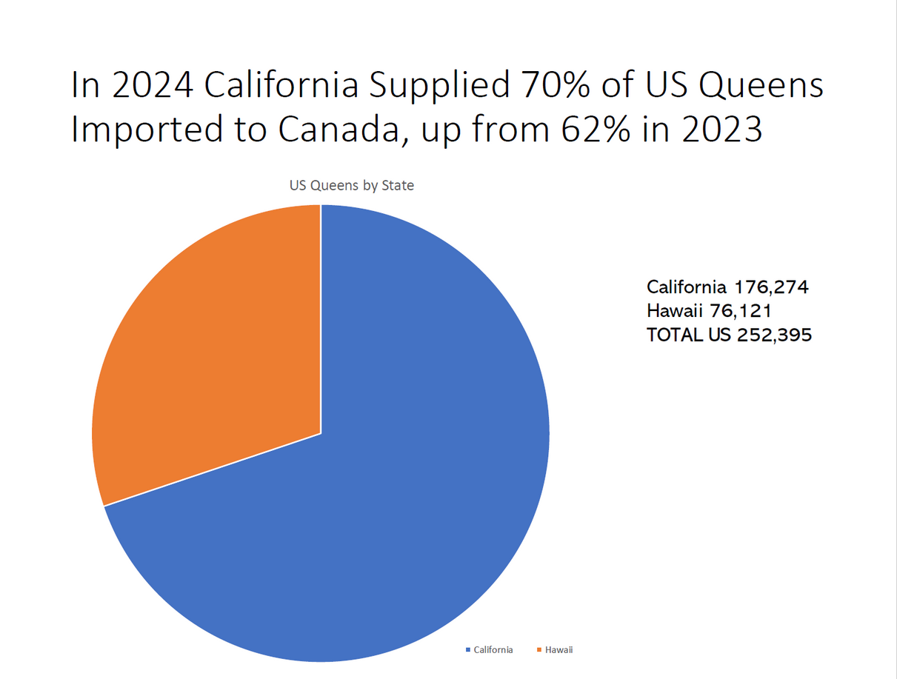
National Statistical Trends , 2024 - Stephen Page, Sector Specialist, Agriculture and Agri-Food Canada

Slide 10
HONEY ISSUES
CHC, WORKING FOR BEEKEEPERS ON NATIONAL OPPORTUNITES AND CHALLENGES TO STRENGHTEN THE CANADIAN BEEKEEPING INDUSTRY.
  Emerging Products
    Products on the grocery store shelf that confuse consumers and threatens the confidence that Canadians have with real honey.
      The appearance of “vegan honey” and “honey spreads” in stores has meant that real honey is now in competition with products that contain little or no honey
  Honey Fraud
    “Synthetic Honey
  Organic Standards
    Are they being applied equally for domestic and imported product?
    Brazil organic honey $1.61/lb????
  Maximum residue limits (MRL’s)
    for glyphosate and quinclorac particularly as it pertains to exports to Japan
  TARRIFFS
    ???
    New Markets

Slide 11
HIVE HEALTH
CHC, WORKING FOR BEEKEEPERS ON NATIONAL OPPORTUNITES AND CHALLENGES TO STRENGHTEN THE CANADIAN BEEKEEPING INDUSTRY.
Issues and actions
  Oxalic-glycerin
    The registration of application is finally in the system at PMRA and we will be urging the fast tracking of approval.
  Fumagilan–B, Formic 65 and Oxytet 25
    Transferred the registration of to Vita Bee Health
  Oxalic acid and oxalic dehydrate
    Currently the PMRA is reviewing the product registration and the CHC re-registration of the product
  Tropilaelaps
    Emerging issue and another CHC committee
    Varroacides
    Promising work though the Honey Bee Health Coalition

Slide 12
LABOUR
CHC, WORKING FOR BEEKEEPERS ON NATIONAL OPPORTUNITES AND CHALLENGES TO STRENGHTEN THE CANADIAN BEEKEEPING INDUSTRY.
A New Foreign Labour Program for Agriculture and Fish Processing
    Canada’s objective is to develop a new agriculture and fish processing stream that leverages the strengths of the existing SAWP, but explores advancements in key areas: Ensuring that employers and TFWs who support Canada’s food supply benefit from more consistent requirements;
  Clarifying roles and responsibilities of stakeholders with renewed country agreements;
  Occupational expansion of country agreements to include year-round primary agriculture work, and seasonal fish, seafood and primary food processing;
  Providing workers with increased labour mobility within the agriculture and fish, seafood and primary food processing sectors;
  Using market-based drivers for wages and deductions and,
  Updating housing requirements to ensure employer-provided TFW housing meets applicable Provincial/Territorial regulations in certain key health and safety areas.
  CHC became the dedicated point of contact for Canadian beekeepers with IRCC issues –contact the office for instructions

Slide 13
STOCK ISSUES
CHC, WORKING FOR BEEKEEPERS ON NATIONAL OPPORTUNITES AND CHALLENGES TO STRENGHTEN THE CANADIAN BEEKEEPING INDUSTRY.
  Risk Assessment Completed
    CFIA decided that there is significant risk importing US packaged bees
  Other risks being evaluated
    Emerging threats
      Tropilaelaps – committee formed
      Letter sent to CFIA to evaluate current protocols in Europe
  Current honey bee import countries
    Australia
    Chile
    Italy/Malta
    New Zealand
    *USA - Queens

Slide 14
HABITAT ENHANCHEMENT
CHC, WORKING FOR BEEKEEPERS ON NATIONAL OPPORTUNITES AND CHALLENGES TO STRENGHTEN THE CANADIAN BEEKEEPING INDUSTRY.
New Project with Project Hive Pet Company
  Current Sites
    2 three acre plots have been planted with a Canadian Honey Bee seed mix
      one in Manitoba
      one in Saskatchewan
      a six acre plot in Alberta
    will be looking to have plot secured in Ontario this year
    Received funding ($149,000 over two years on a 75-25 funding basis) from the Canadian
Agricultural Strategic Priorities Program to “Finding a Better Path Forward Cultivating Solutions to
Challenges Facing the Canadian Beekeeping Industry”

Slide 15
HONEY ISSUES
CHC, WORKING FOR BEEKEEPERS ON NATIONAL OPPORTUNITES AND CHALLENGES TO STRENGHTEN THE CANADIAN BEEKEEPING INDUSTRY.
Working with CFIA to increases the testing of honey both imported and exported for adulteration
Working to ensure the definition of honey is a product of bees and getting that enforced
Seeking opportunities to expand our honey market sales
- Issues in Europe with GMO but are there are new opportunities arising
- MRL issues in Japan
OECD working on setting maximum residue levels for out of hive products
- could create problems both good and bad
- resolve a quinclorac concern depending on where the level is set
- opens the door to a myriad of potential tests
- could close off markets
- what does it do to the reputation of honey

Slide 16
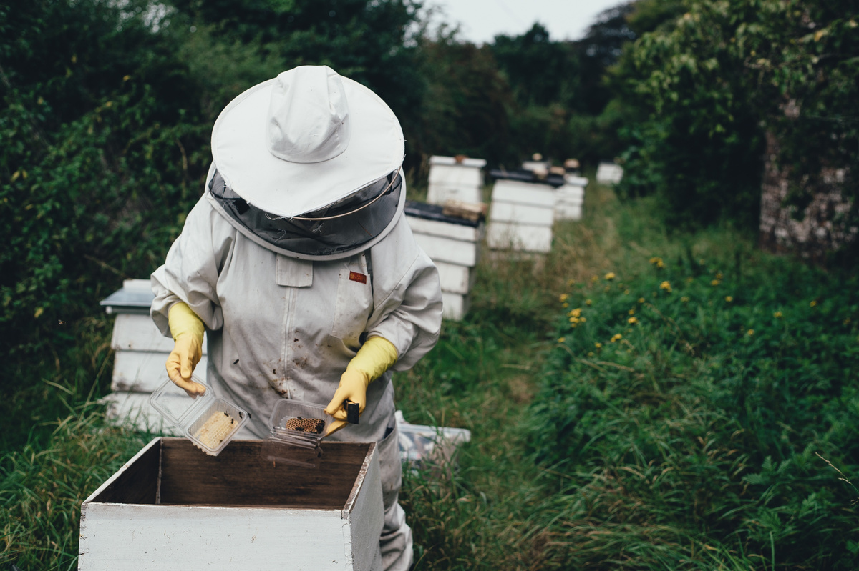
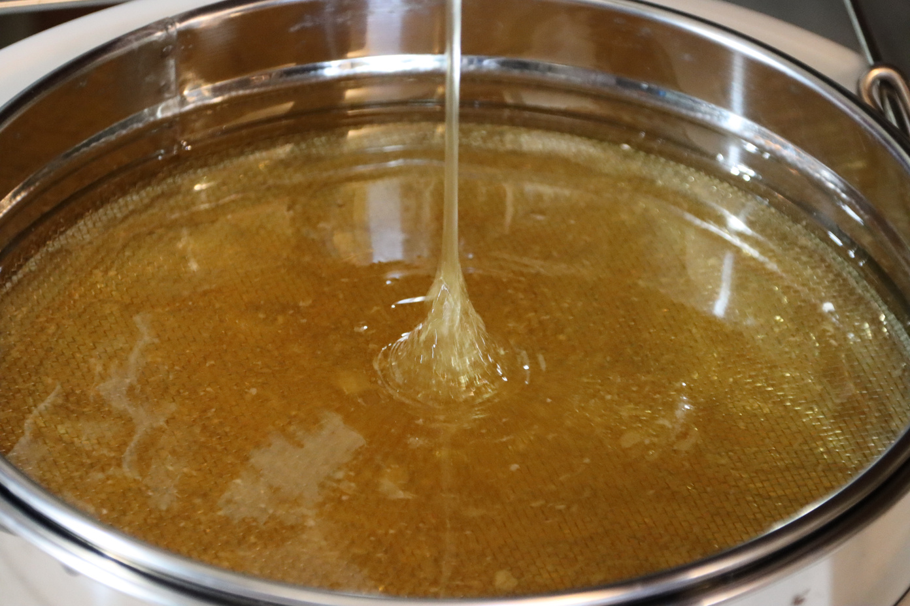

STANDING COMMITTEES
CHC, WORKING FOR BEEKEEPERS ON NATIONAL OPPORTUNITES AND CHALLENGES TO STRENGHTEN THE CANADIAN BEEKEEPING INDUSTRY.
LABOUR
  JAKE BERG
STOCK REPLACEMENT
  REAL DUBEAU
HONEY/FOOD SAFETY
  ALBERT DEVRIES/MARINA OIRIK
POLLINATION
  MAGGIE LAMOTHE BOUDREAU
HIVE HEALTH
  LORNE PRINS
TECH TRANSFER TEAM LIASON
  RODNEY REID/JEFF LEE
INTERPROVINCIAL MOVEMENT
  OSEE PODOLSKY
NORTH AMERICAN STRATEGY
  JEREMY OLTHOF
PRA (PROMOTING RESEARCH AGENCY)
  JEREMY OLTHOF
INTERPROVINCIAL MOVEMENT
  OSEE PODOLSKY
Other...

Slide 17
QUESTIONS?
THANK YOU
CONTACT INFORMATION
WWW.HONEYCOUNCIL.CA
Rod Scarlett
Chc-ccm@honeycouncil.ca

